Slide 1
Table of Contents
Opening Circle
4. Swift: Arrays & Loops
Brain Break 1
5. Swift: Functions & Closures
Lunch
6. SwiftUI: Views, Stacks, & Modifiers
Brain Break 2
CoT1 (Part 2): KWK & Me
Closing Circle

Slide 2
Welcome to Day 2!
Remember to rename yourself in zoom with your house letter

Slide 3
Today’s Schedule
Morning Session
9:30 - 9:50 | Opening Circle
9:50 - 12:00 | 4. Swift: Arrays & Loops 5. Swift: Functions & Closures
Afternoon Session
12:45 - 2:40 | 6. SwiftUI: Views, Stacks, & Modifiers Culture of Tech (Part 2): KWK & Me
2:40 - 3:00 | Closing Circle + Microfeedback

Slide 4
Kode With Klossy Commitments
We disrupt the status quo.
We meet ourselves and others where we are.
We make it safe for everyone’s voice to be heard.
We have boundless curiosity.
We dream big and aim high.
We dare to take risks.
We are all lifelong learners.
🤔 What do these commitments mean to me? What might it look and sound like for us to live out these commitments?

Slide 5


Microfeedback Trends
Strengths:
Enjoyed brain breaks!
Loved meeting new people!
Exciting to write first lines of code in Swift!
Areas of Growth:
Text was sometimes small during lessons,
Wanting longer breaks
More opportunities to get to know each other
Varied feedback on pacing based on past coding experience

Slide 6
Opening Circle

Slide 7
Swift: Arrays & Loops
We’ll get started momentarily:
we’d love to see you camera on!

Slide 8
Understand what an array is and why they are useful
Create arrays and access data from them
Explain the concept of iteration
Use for-in loops to iterate over collections

Slide 9
Array
Element
Index
Initialize
Iterate
Loop

Slide 10
Getting Started
Create a new Xcode playground and save it as 3_ArraysAndLoops.
Make sure you save it somewhere you can find it again later!

Slide 11
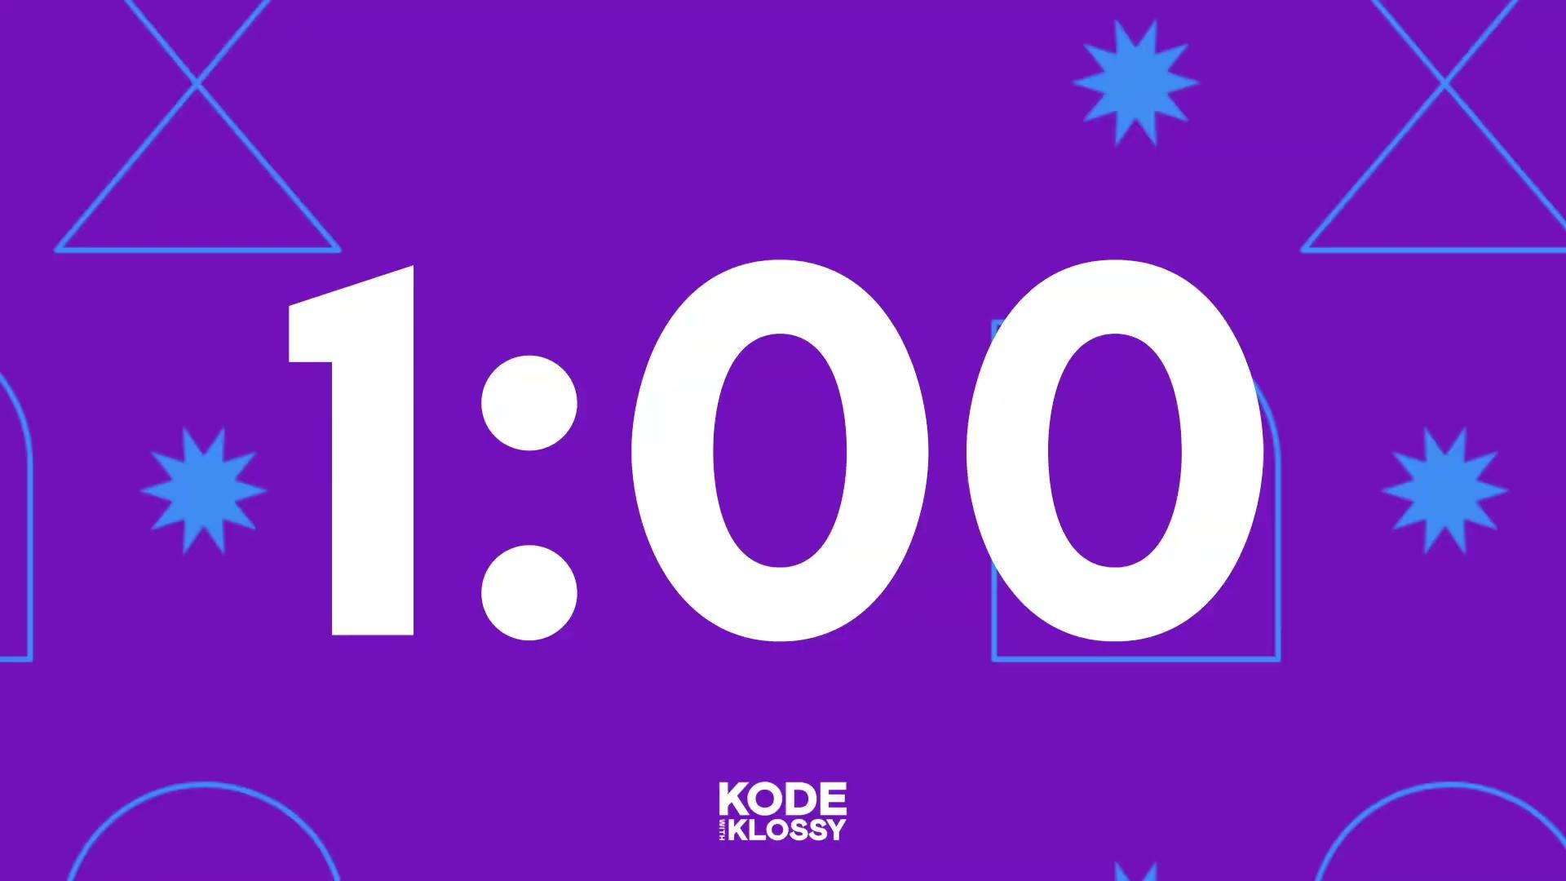
Warm-Up
In your Xcode playground, declare a variable for every scholar in your house.
The variable names should be something like scholar1, scholar2, etc.
The values should be strings of their first names.

Slide 12
What did you think of that warm-up?

Slide 13
Collections
An ordered collection that allows duplicates.
Array
var groceries: Array = ["bananas", "milk", "eggs", "flour", "milk"]
An unordered collection of unique values.
Set
var genres: Set = ["Rock", "Jazz", "Classical", "Hip Hop"]
A key-value collection that allows fast lookups.
Dictionary
var airports: Dictionary = ["CAI": "Cairo", "DUB": "Dublin", "LHR": "London"]

Slide 14
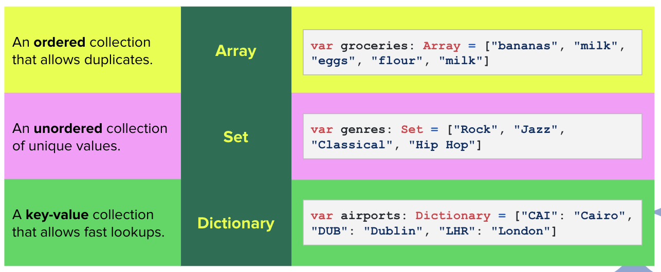
Collections

Slide 15
Arrays

Slide 16
What are Arrays?
Arrays store multiple values in a numerical order.
Helps keep track of an ordered list of things
All the information is stored in a single variable
A single array holds a lot of items that are all of the same type of data
Can be accessible by the location of the data on the list
Think back to the Warm-Up: If there are 15 or 20 scholars in your house, writing out a variable for each one can be time-consuming. An array will allow us to store all scholar names in one variable!

Slide 17

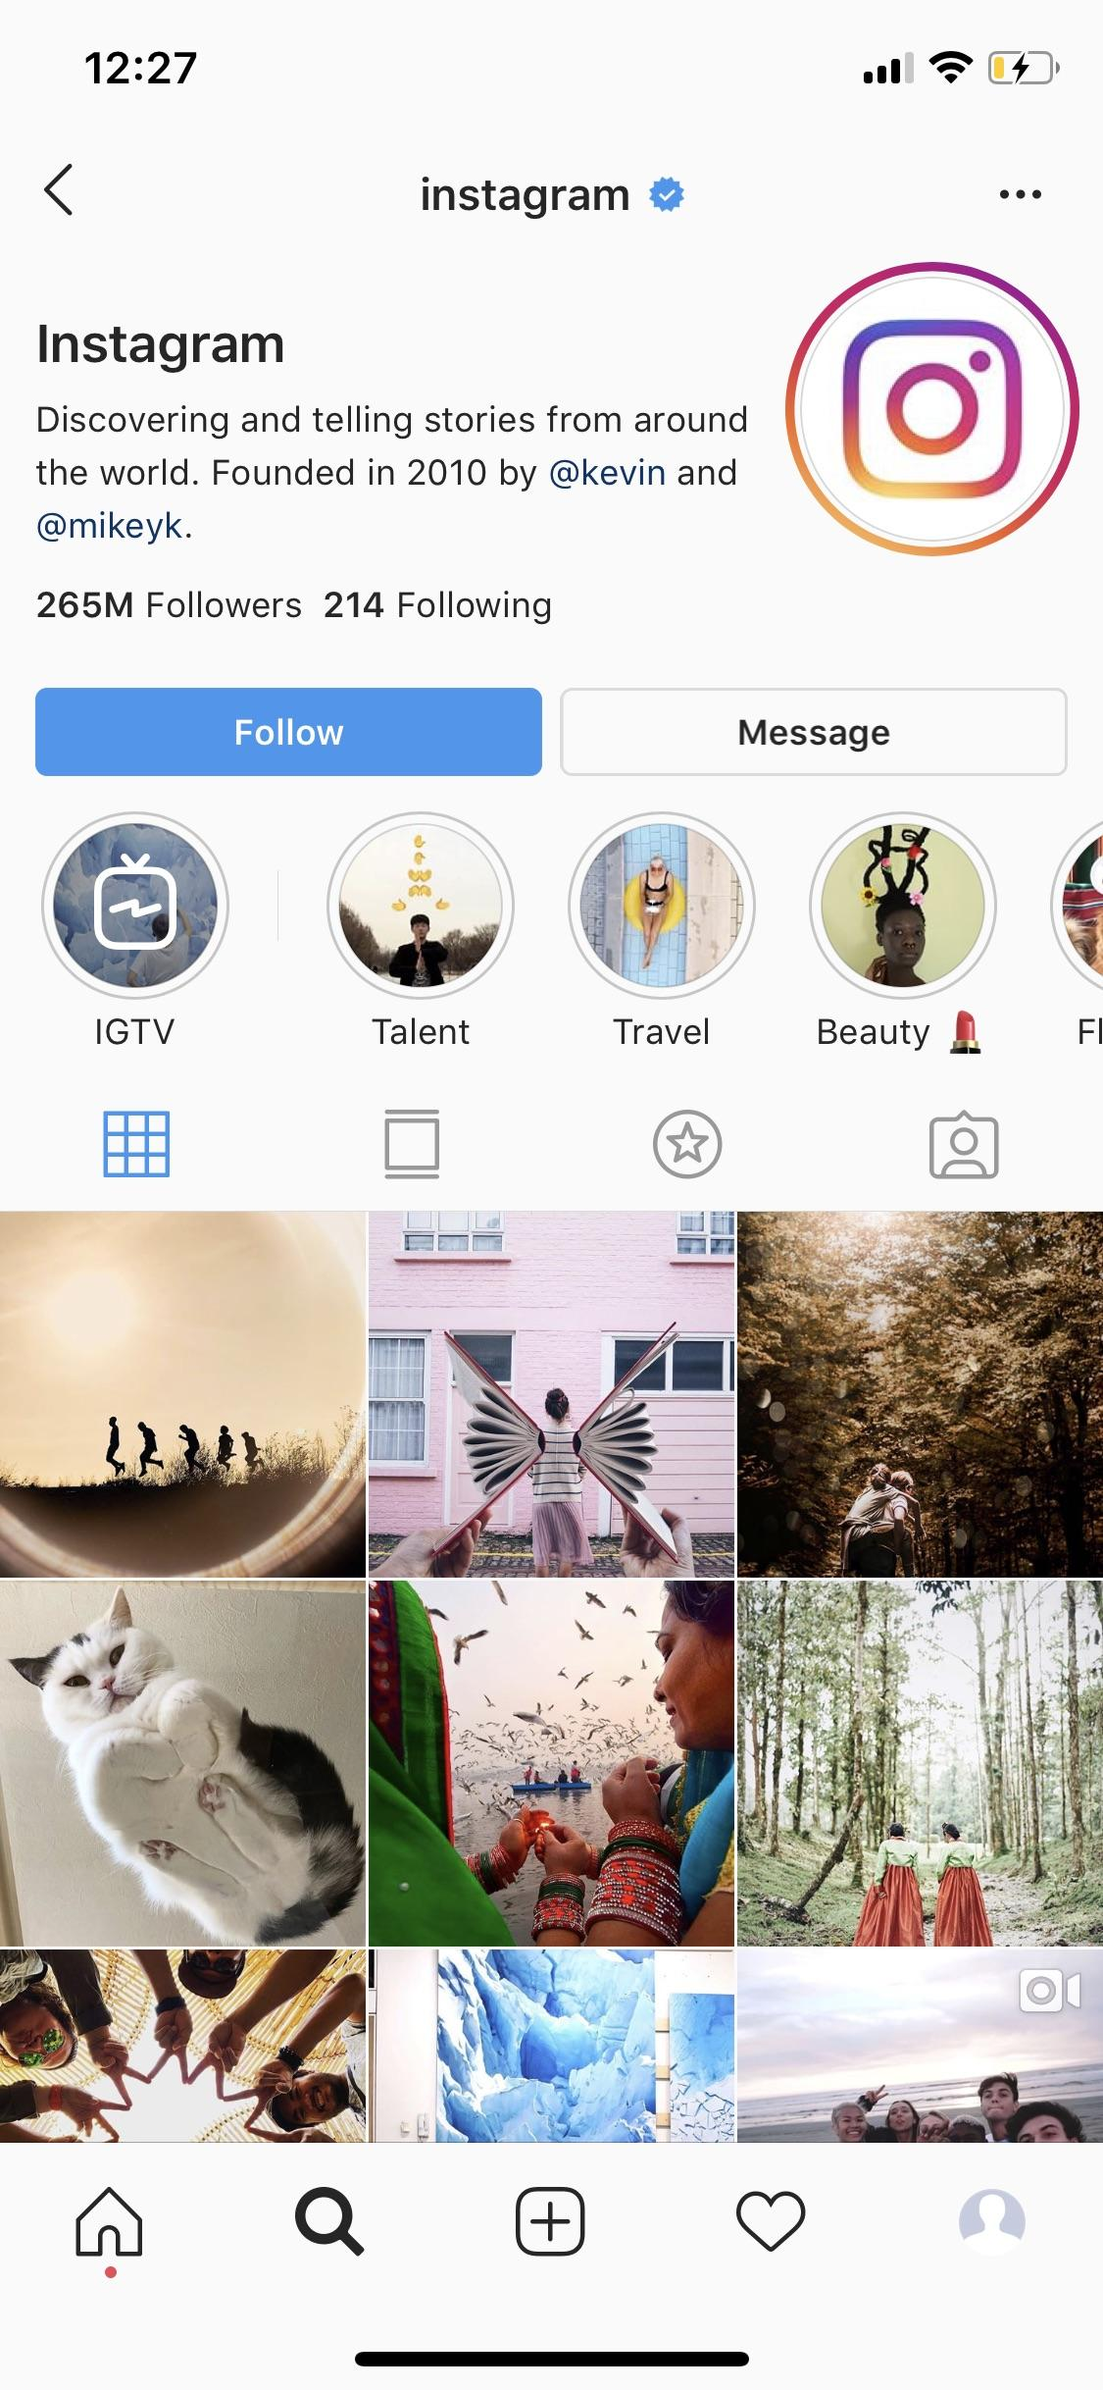
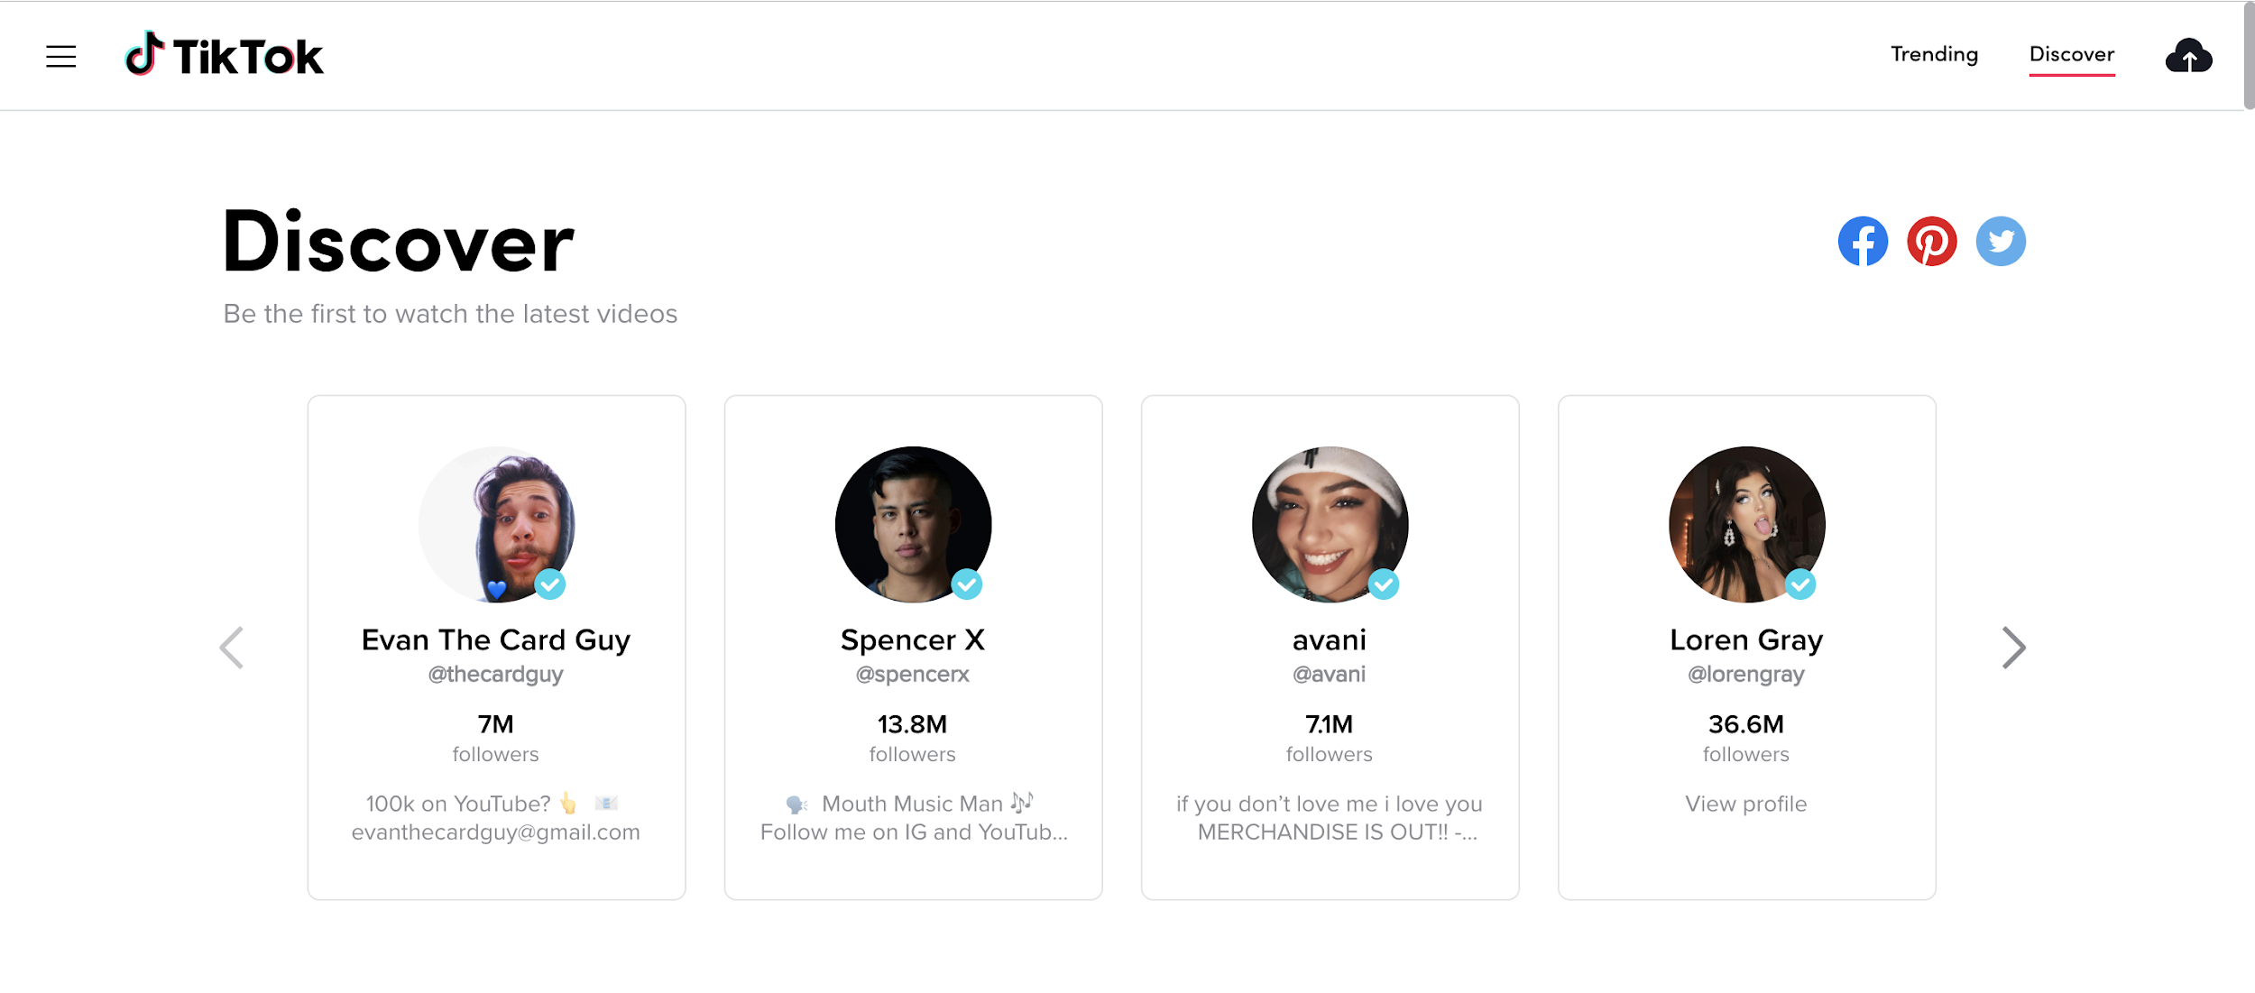
Discuss
Think about Instagram or TikTok: Where and how might each of these applications use arrays?

Slide 18
Arrays IRL
Instagram
Twitch
Apple Music
Uses arrays to hold all the posts for a given user.
Example
Alfie the Alpaca has over 1000 posts, so the array is over 1000 elements long!
Has an array of recommended channels.
Example
They advertise these channels in the top left corner of their landing page.
Playlists on Apple Music are curated arrays of songs.
Example
When a user clicks on the playlist artwork, Apple Music shows them a list of all the songs within that playlist.
These are just a few examples!

Slide 19

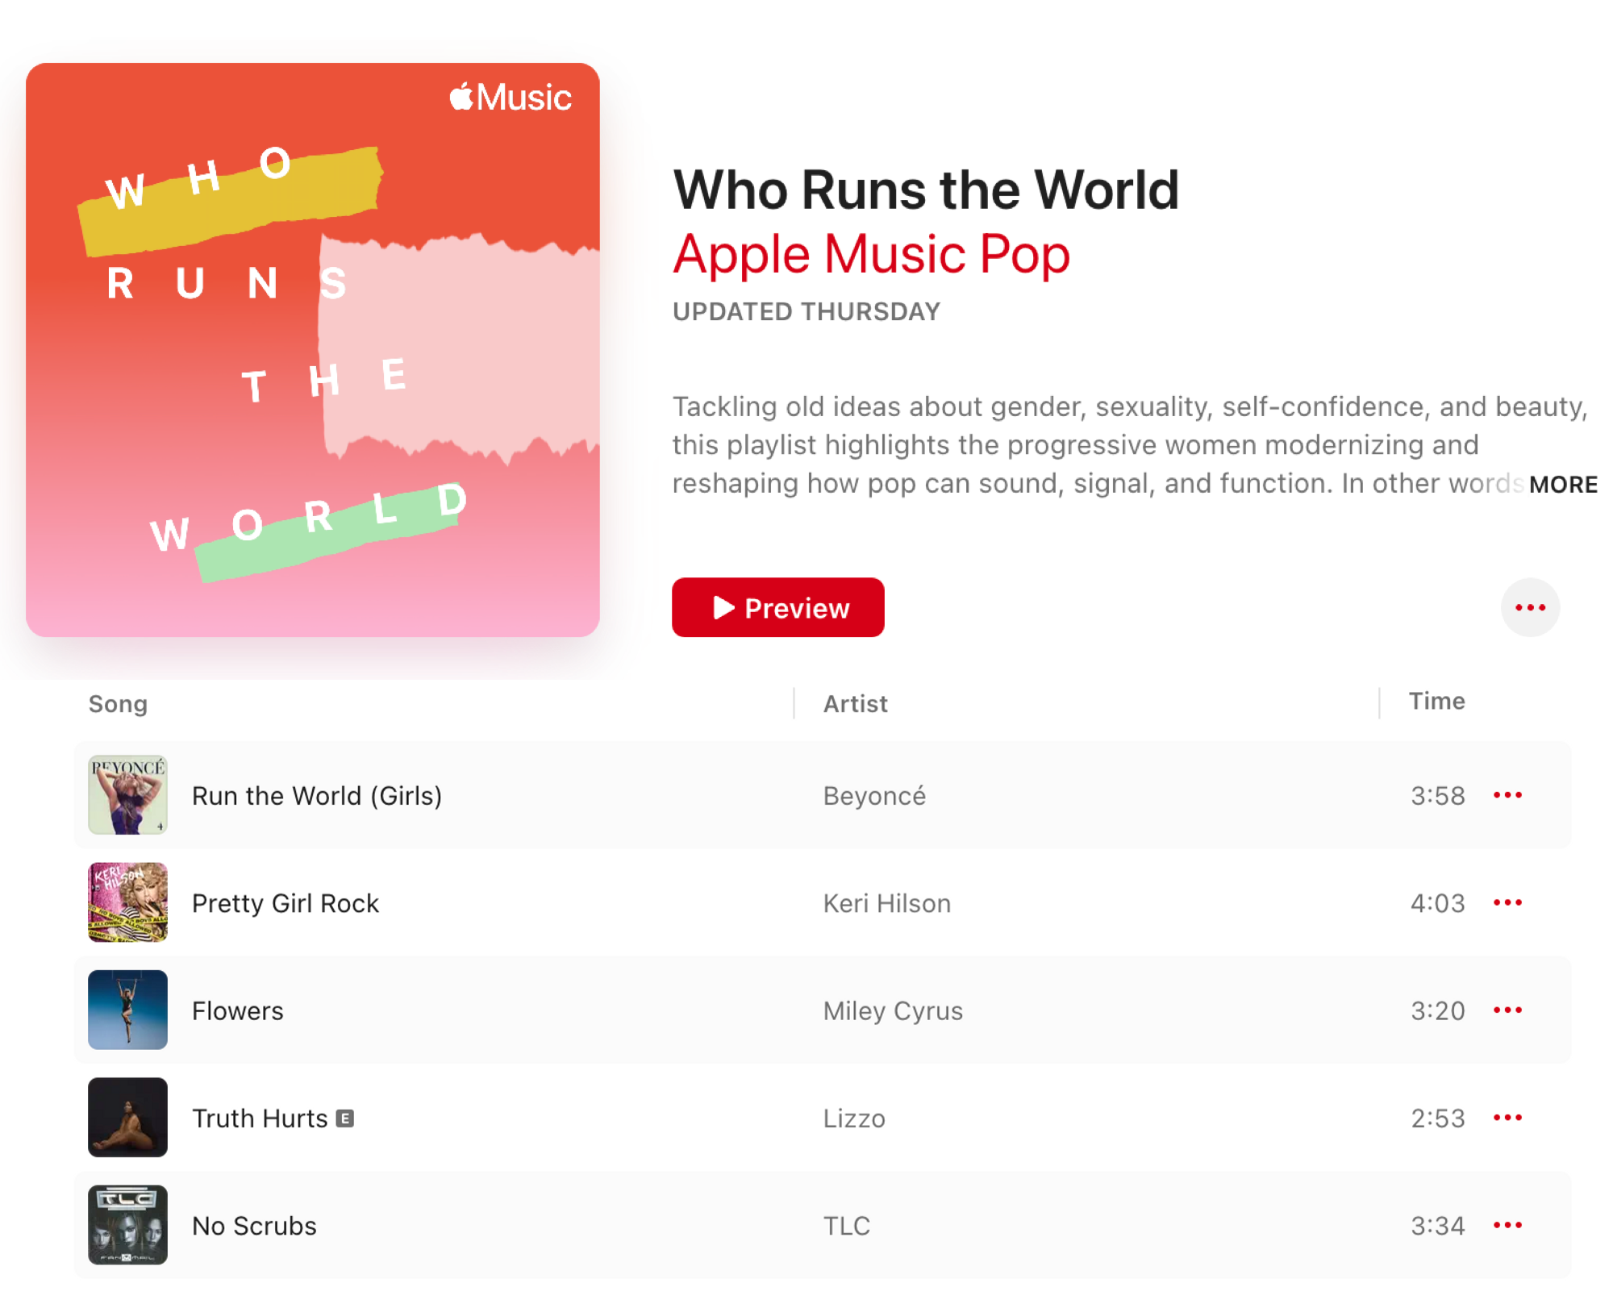

How could you organize this information into arrays?
‹#›

Slide 20

How Do We Create an Array?
There are two ways to initialize (i.e. create) an array.
EMPTY
WITH DATA
var viralHits = [String]()
var durationInSeconds = [Int]()
var viralHits = ["Run the World (Girls)", "Pretty Girl Rock", "Flowers", "Truth Hurts", "No Scrubs"]
var durationInSeconds = [238, 243, 200, 173, 214]
var name : String
var lastNumber : Int
var name = "Reminders"
var lastNumber = 42

Slide 21

How To Create an Empty Array
name of array
data type in square brackets
var viralHits = [String]()
assignment operator
keyword
pair of empty parentheses

Slide 22
How to Create an Array with Data
name of array
assignment operator
var viralHits = [ "Run the World (Girls)",
"Pretty Girl Rock",
"Flowers",
"Truth Hurts",
"No Scrubs"
]
data separated by commas in square brackets
keyword
Each item in an array is called an element.

Slide 23
Referencing an Array
Anytime we reference the name of the array, we are referring back to the entire list of songs!
var viralHits = ["Run the World (Girls)", "Pretty Girl Rock", "Flowers", "Truth Hurts", "No Scrubs"]
print(viralHits)
//-> ["Run the World (Girls)", "Pretty Girl Rock", "Flowers", "Truth Hurts", "No Scrubs"]

Slide 24
Discuss
Imagine you’re building an app to save and share recipes.
How might you use arrays in this app?
Can you think of when you might initialize an array without data?

Slide 25
Array Indexes
An index is the position of an element within an array.
Indexes are typically used to access, modify, or iterate through elements.
The first element is at index 0, the second at index 1, and so on.
0 -–->
1 –-–>
2 –-->
3 -–->
4 -–->
var viralHits = [ "Run the World (Girls)",
"Pretty Girl Rock",
"Flowers",
"Truth Hurts",
"No Scrubs"
]

Slide 26
Syntax for Accessing an Element
Use the name of the array followed by the index in square brackets to access an element in the array.
var viralHits = ["Run the World (Girls)", "Pretty Girl Rock", "Flowers", "Truth Hurts", "No Scrubs"]
print(viralHits[0])//->
print(viralHits[3])//->

Slide 27
Syntax for Accessing an Element
Use the name of the array followed by the index in square brackets to access an element in the array.
var viralHits = ["Run the World (Girls)", "Pretty Girl Rock", "Flowers", "Truth Hurts", "No Scrubs"]
print(viralHits[0])//-> "Run the World (Girls)"
print(viralHits[3])//-> "Truth Hurts"

Slide 28
Checking the Number of Elements
Use the .count property to return the number of elements in an array.
var viralHits = ["Run the World (Girls)", "Pretty Girl Rock", "Flowers", "Truth Hurts", "No Scrubs"]
print(viralHits.count) //-> 5

Slide 29

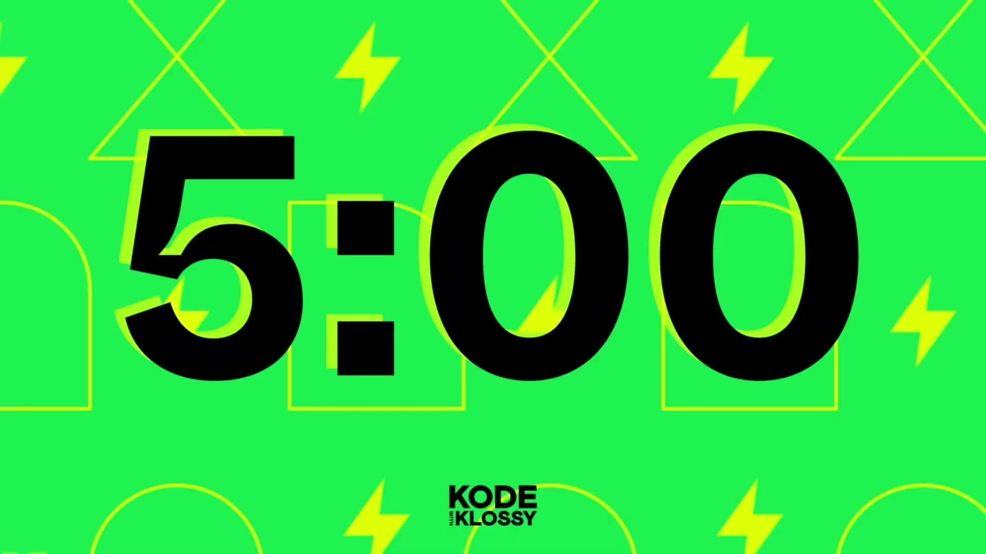
Try-It | Creating Arrays
In your Xcode Playground, create a variable that stores an array of at least 4 strings - you choose what the content is about. The variable name should describe the type of data those 4 strings hold.
Write print statements to:
print the first element
print the last element
print the second element

Slide 30
Updating Information
To update an element in an array, use indexing to assign a new value to a specific position in the array.
var viralHits = ["Run the World (Girls)", "Pretty Girl Rock", "Flowers", "Truth Hurts", "No Scrubs"]
viralHits[1] = "Die For You (Remix)"
print(viralHits)
//=> ["Run the World (Girls)", "Die For You (Remix)", "Flowers", "Truth Hurts", "No Scrubs"]

Slide 31
Adding Information
To add an element to the end of an array, use the built-in .append() method.
var viralHits = ["Run the World (Girls)", "Die For You (Remix)", "Flowers", "Truth Hurts", "No Scrubs"]
viralHits.append("Pretty Girl Rock")
print(viralHits)
//-> ["Run the World (Girls)", "Die For You (Remix)", "Flowers", "Truth Hurts", "No Scrubs", "Pretty Girl Rock"]

Slide 32
Removing Information
To remove an element from an array, use the built-in .remove(at:) method and specify the index.
var viralHits = ["Run the World (Girls)", "Die For You (Remix)", "Flowers", "Truth Hurts", "No Scrubs", "Pretty Girl Rock"]
viralHits.remove(at: 0)
print(viralHits)
//-> ["Die For You (Remix)", "Flowers", "Truth Hurts", "No Scrubs", "Pretty Girl Rock"]

Slide 33
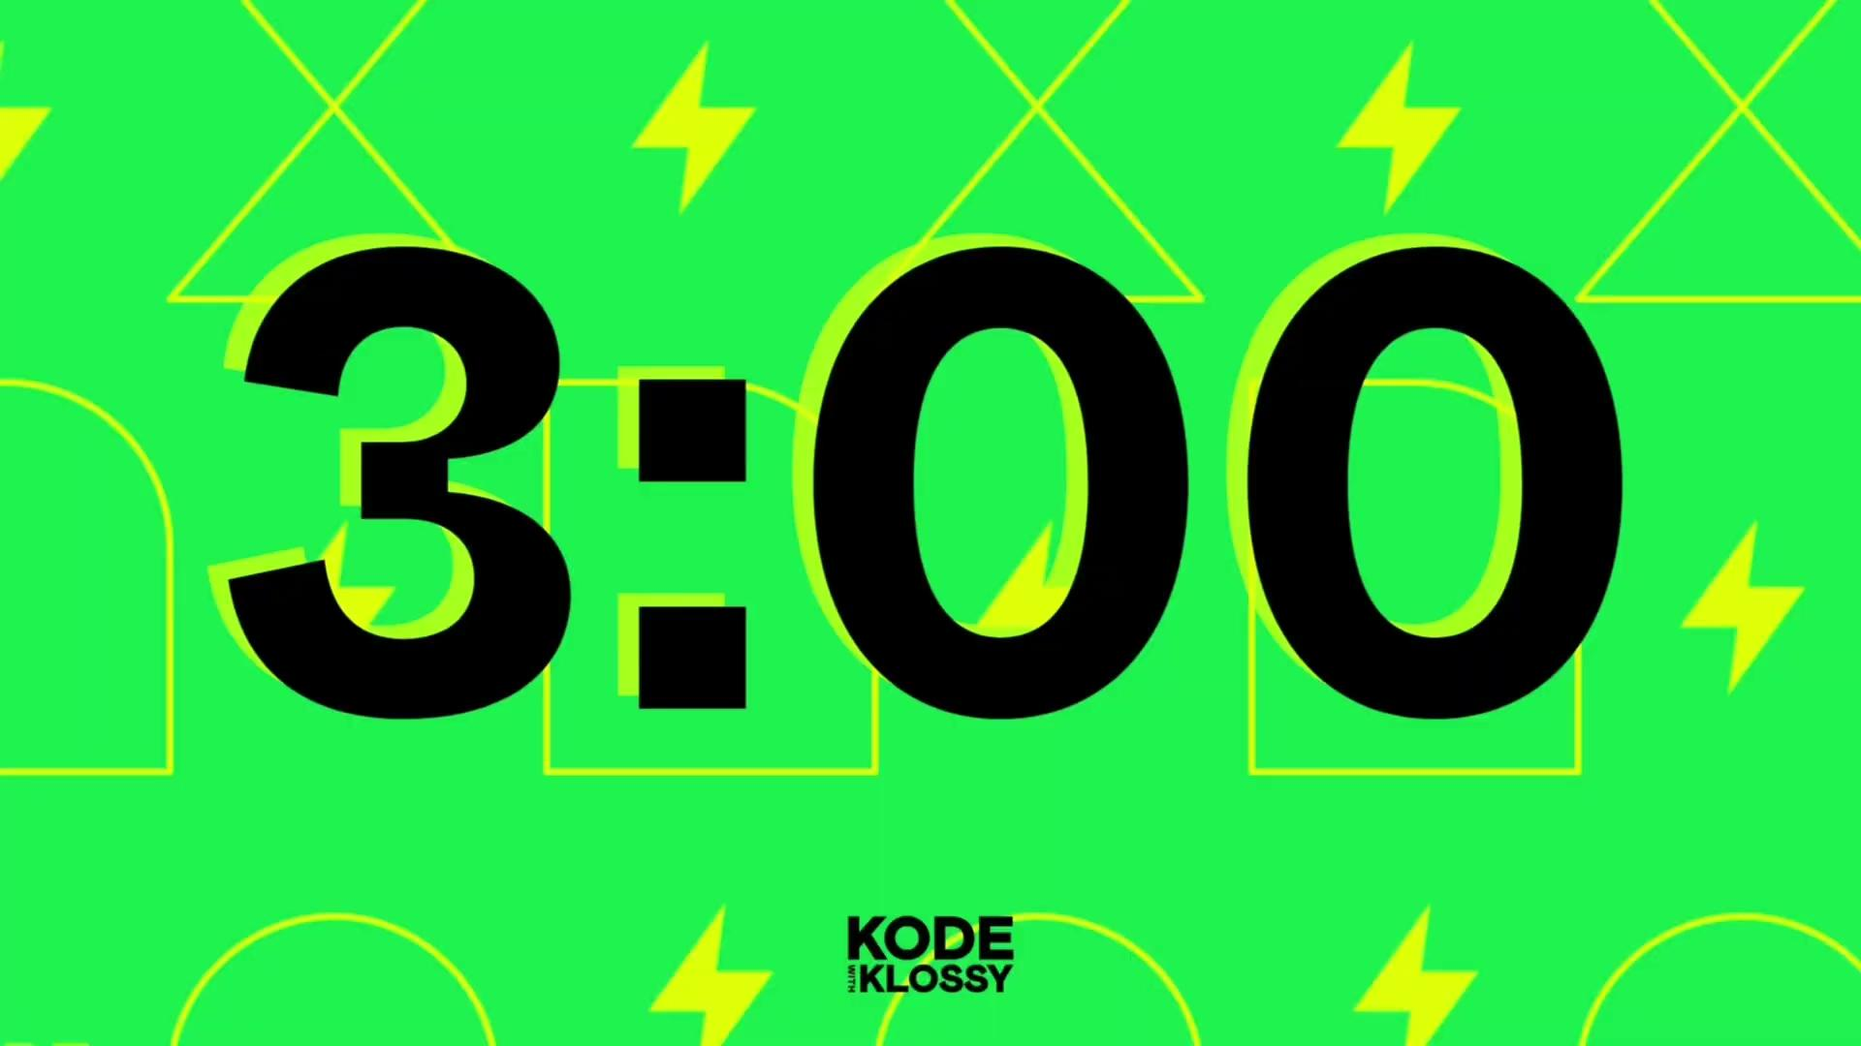
Try-It | Modifying Arrays
Use the array you created in the previous Try-It exercise.
Update one of the elements to a new value. Print the array to see the change.
Add two new elements into your array. Use a print statement to make sure they were added.
Remove the last 2 elements from your array. Use a print statement to make sure they were removed.
Check the outputs in the console to make sure it’s what you expected.

Slide 34
Do you need a break?

Slide 35
Iteration & Loops

Slide 36
Iteration
Iteration is the process of repeating a set of instructions a certain number of times.

Slide 37
A World Without Loops
If we wanted to print each string in the viralHits array without a loop, our code would look like this:
var viralHits = ["Die For You (Remix)", "Flowers", "Truth Hurts", "No Scrubs", "Pretty Girl Rock"]
print("Have you heard \(viralHits[0]) yet?!")
print("Have you heard \(viralHits[1]) yet?!")
print("Have you heard \(viralHits[2]) yet?!")
print("Have you heard \(viralHits[3]) yet?!")
print("Have you heard \(viralHits[4]) yet?!")

Slide 38
Iteration
Iteration is the process of repeating a set of instructions a certain number of times.
A for-in loop is a block of code that will iterate over a collection, such as an array, and perform the same action on each element in the array.

Slide 39
Syntax
With a for-in loop, we can print each element in the array with just a few lines of code:
var viralHits = ["Die For You (Remix)", "Flowers", "Truth Hurts", "No Scrubs", "Pretty Girl Rock"]
for song in viralHits {
print(song)
}
this code block runs for every song in the viralHits array

Slide 40
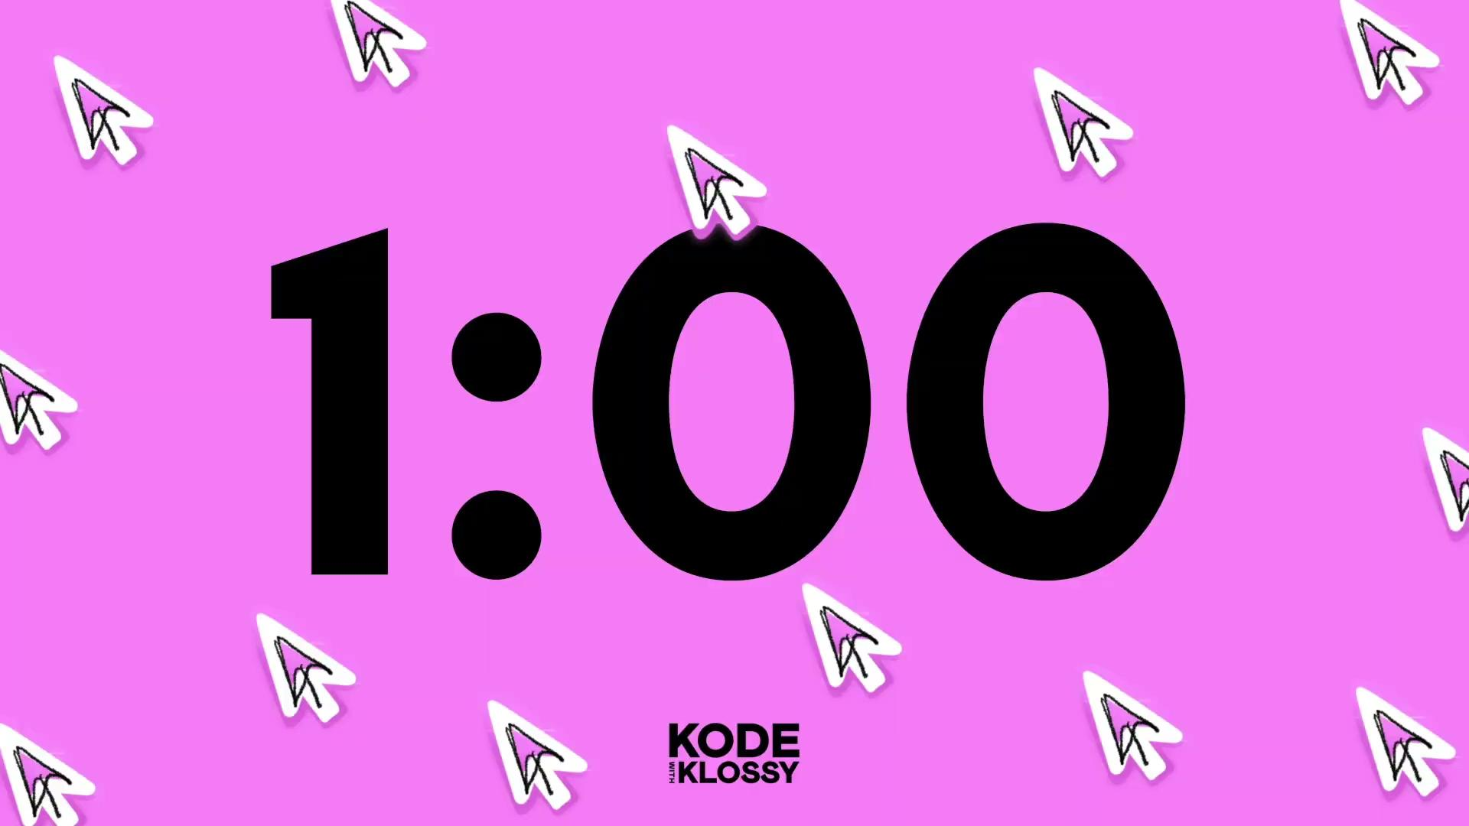
Think About It
What do you think will happen when we run the code below?
What if we add another song to our array?
Why do you think we used song and viralHits in our for-in loop?
var viralHits = ["Die For You (Remix)", "Flowers", "Truth Hurts", "No Scrubs", "Pretty Girl Rock"]
for song in viralHits {
print(song)
}

Slide 41
Breaking Down the Syntax
keywords
name of array
for song in viralHits {}
local variable that refers to a single element in the array
pair of curly brackets containing the code block

Slide 42
Breaking Down the Syntax
var viralHits = ["Die For You (Remix)", "Flowers", "Truth Hurts", "No Scrubs", "Pretty Girl Rock"]
for song in viralHits {
print(song)
}
// => Die For You (Remix)
// => Flowers
// => Truth Hurts
// => No Scrubs
// => Pretty Girl Rock
The loop runs based on the number of elements in the array.
Since viralHits has 5 elements, the loop runs 5 times.
Adding another song would make it run 6 times.
Each element is stored in a local variable, and the code block runs with that value.

Slide 43
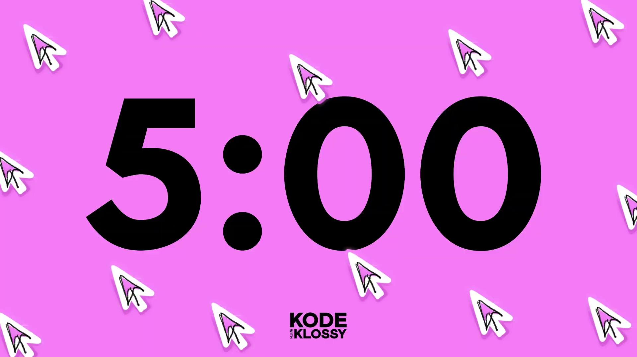
Try-It | Looping Over Arrays
Declare an array of the names of your friends or favorite people.
Write a for-in loop that uses each name and prints Hello, [scholar name] to the console.
Declare an array of the names of four things you already learned about Swift.
Write a for-in loop that uses each thing you learned and prints I learned [thing I learned] at KWK to the console.
Share in your Slack Thread:
What did you name your arrays?
What word did you use as the local variable that holds each individual element?

Slide 44
Discuss
What is a for-in loop? What does it do?
What are the different ways you might use a for-in loop?
How can for-in loops be useful? What do you think is the point of them?
Can you brainstorm some ways that one of your favorite apps might make use of a for-in loop?

Slide 45
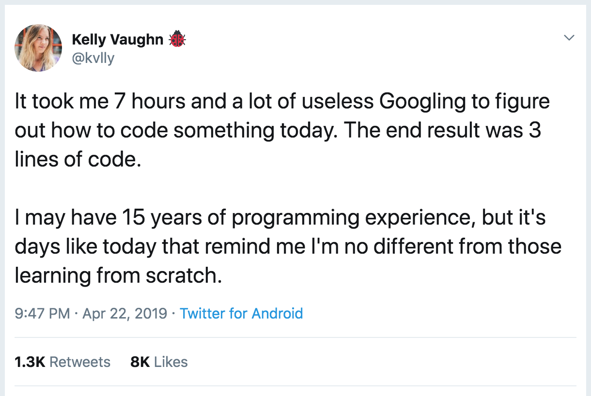
Putting It All Together
You don’t need to memorize everything! Even experienced developers don’t rely on memory alone.
Resources to find and apply the right information when you need it:
Swift documentation
KWK Lessons
Search online

Slide 46
Extensions

Slide 47

Random Elements
Int.random(in: 0..<20) generates an Integer starting at 0 and less than 20, which we store in a variable.
var randomInt = Int.random(in: 0..<20)
print(randomInt) //=> 7 (number will vary)
var anotherRandomInt = Int.random(in: 0..<20)
print(anotherRandomInt) //=> 19 (number will vary)

Slide 48
Picking a Random Student
var students = ["Leta", "Ellen Mary", "Pam", "Megan", "Amy", "Sarah", "Robyn", "Courtney", "Rachel", "Allison", "Ruby", "Maile", "Julie", "Meg", "Christie", "Emmie", "Aurora", "Tori", "Juliana", "Kerry"]
var randomInteger = Int.random(in: 0..<20)
var randomStudent = students[randomInteger]
print(randomStudent)
//=> one random element from the array will print out

Slide 49
Discuss
Considering the section on selecting random elements from an array, answer the following questions with your group:
What does Int.random() do?
Why do we have to pass an argument, or put information inside the parenthesis for Int.random()?
How would you generate a number between 1 and 100?
300 and 350?
Is it possible for the pickStudent function to ever return
the same number? Why or why not?

Slide 50
Try-It | Accessing Random Elements
Declare a variable called favAccounts that stores an array of your top five favorite accounts to follow on social media, in strings.
Print one account to the console, at random.
Repeat this a few times to ensure your code is working.

Slide 51
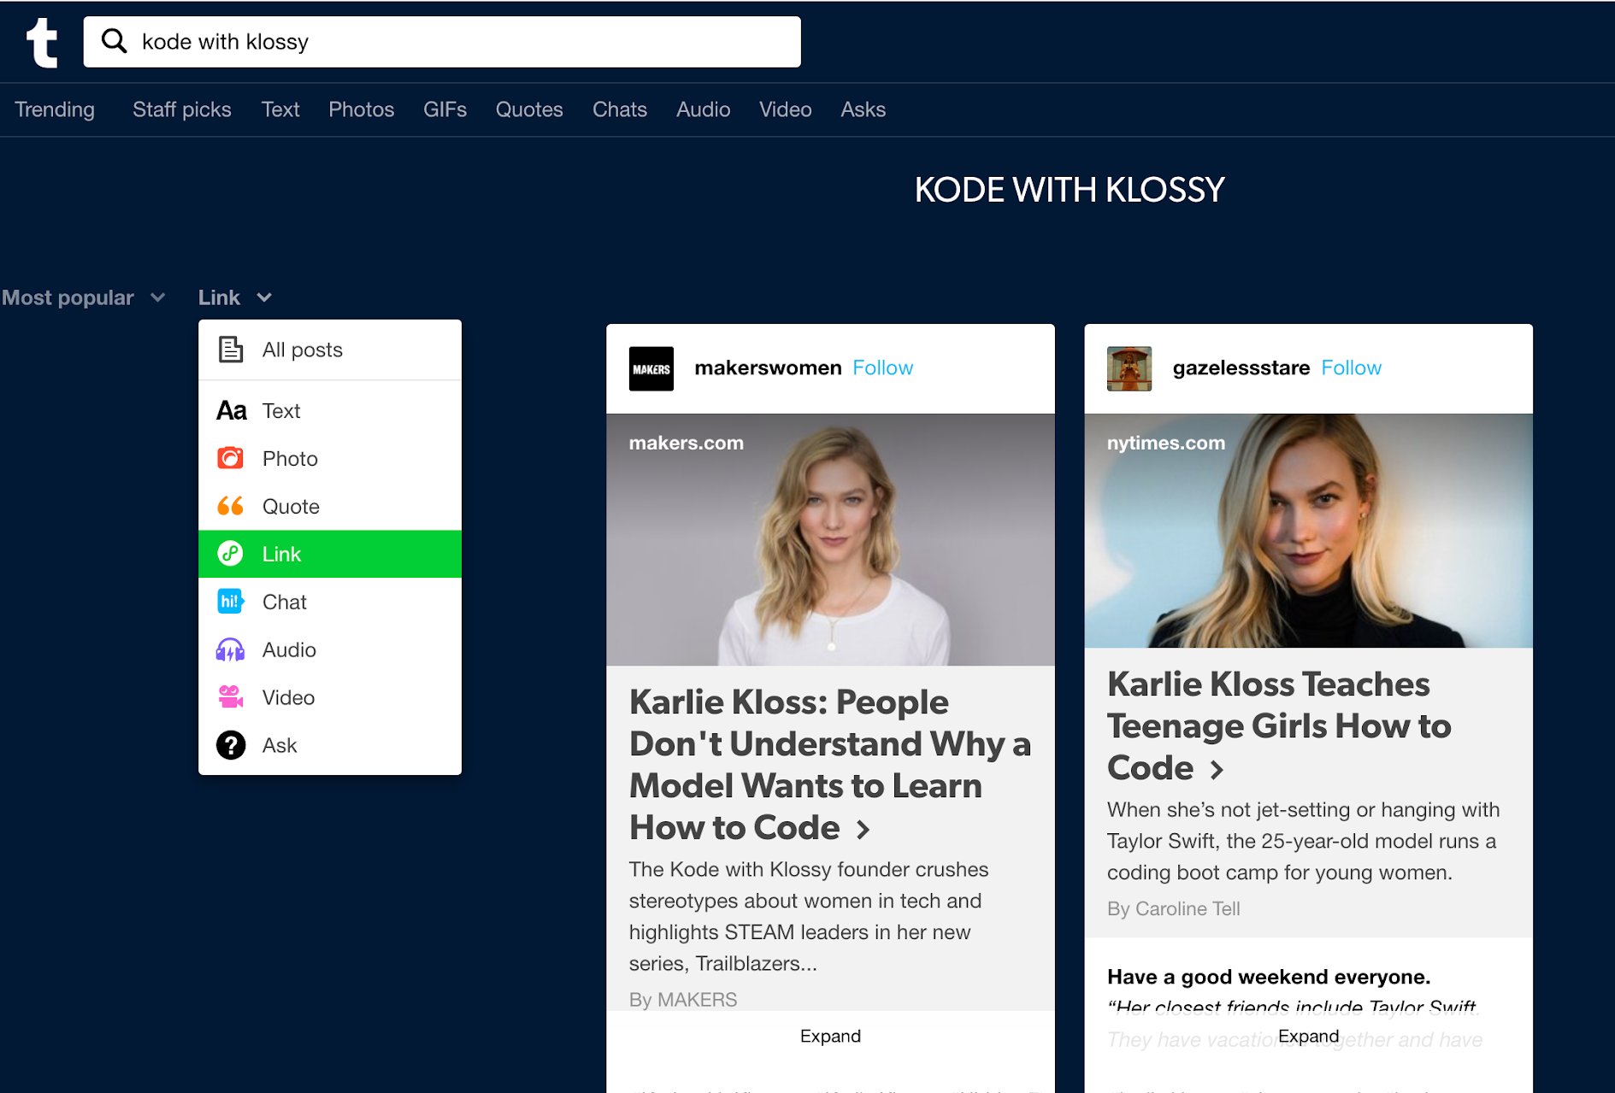
Filtering a Collection with Placeholder Arrays
You can also use for-in loops to:
combine elements
filter the elements
Example: When the user selects “Link” from the dropdown, the results are filtered for only posts that are links.
To accomplish this behavior, it’s common to use a placeholder array.

Slide 52
Example of Filtering with a Placeholder Array
start with an array of numbers
initialize an empty placeholder array
var numbers = [1, 4, 23, 14, 5, 11, 6, 92]
var largeNumbers = [Int]()
for number in numbers {
if number > 10 {
largeNumbers.append(number)
}
}
print(largeNumbers) //-> [23, 14, 11, 92]
if the current element is greater than 10, add it to the largeNumbers array
iterate over the array

Slide 53
Try-It | Placeholder Arrays
Declare an array that contains at least five strings and store it in a variable. You choose what the words are!
Use a for-in loop to create a new array of the words from your original array that have less than 6 characters.
Use print() to verify your new array holds what you think it does.

Slide 54
Using for-in Loops Without a Collection
the underscore (_) is used instead of a variable name because the loop does not need the index
for _ in 1...4 {
print("Hello!")
}
//-> "Hello!"
//-> "Hello!"
//-> "Hello!"
//-> "Hello!"
for number in 1...4 {
print(number)
}
//-> 1
//-> 2
//-> 3
//-> 4
a range represents a sequence of values between a start and an end point: 1...4 is almost like [1, 2, 3, 4]

Slide 55
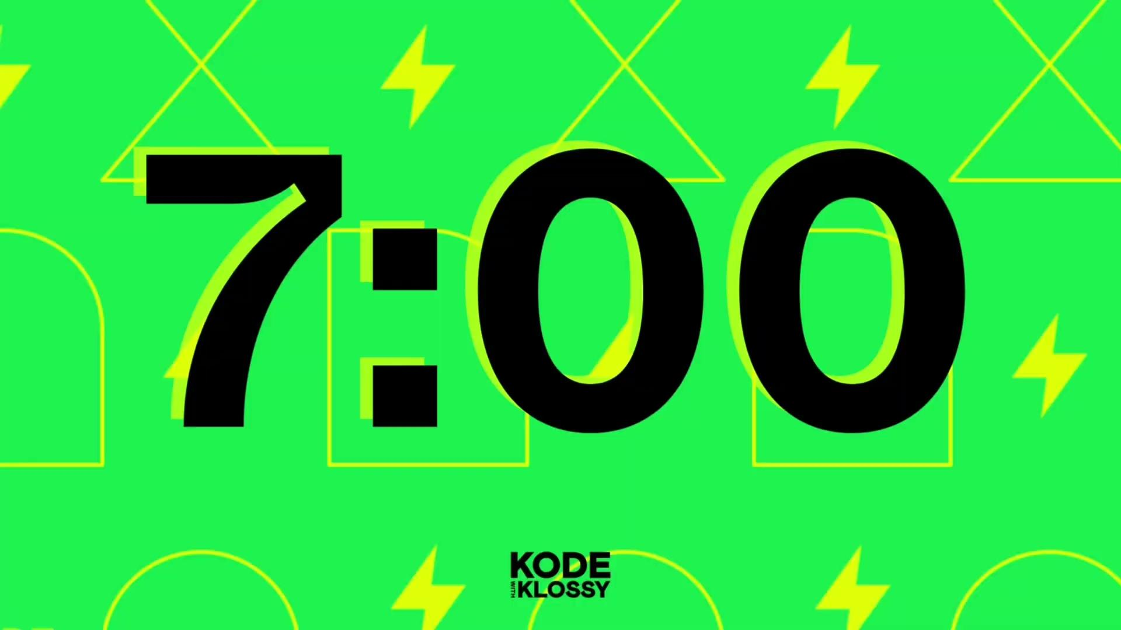
Try-It | Loops Without Collections
🌶️ Mild Challenge: Write a for-in loop that prints Are we there yet? to the console 100 times.
🌶️🌶️ Medium Challenge: Write a for-in loop that prints I’ve had ___ frappuccinos today… to the console 5 times, starting at 7.
🌶️🌶️🌶️ Spicy Challenge: Write a for-in loop that prints I’ve had ___ frappuccinos today… to the console 10 times, with the numbers 0 - 9 filled in for the blank. However, the second statement printed out technically has incorrect grammar. That sentence should say I’ve had 1 frappuccino today…, with frappuccino being singular. How can you utilize other concepts you've learned this week to accomplish that?

Slide 56
Practice
Reference the practice in the lesson for details!

Slide 57
Brain Break

Slide 58
Swift: Functions & Closures
We’ll get started in just a bit: we’d love to see your camera on!
Please also take a moment to rename yourself so your House letter is first! 😊

Slide 59
Explain the concept of functions
Write and call functions with parameters and return values
Differentiate between named functions and closures
Apply functions and closures to solve programming challenges

Slide 60
Argument
Call/Run
Declare
Function
Parameter
Return Value
Closure

Slide 61
Getting Started
Create a new Xcode playground and save it as 4_FunctionsAndClosures.
Make sure you save it somewhere you can find it again later!

Slide 62
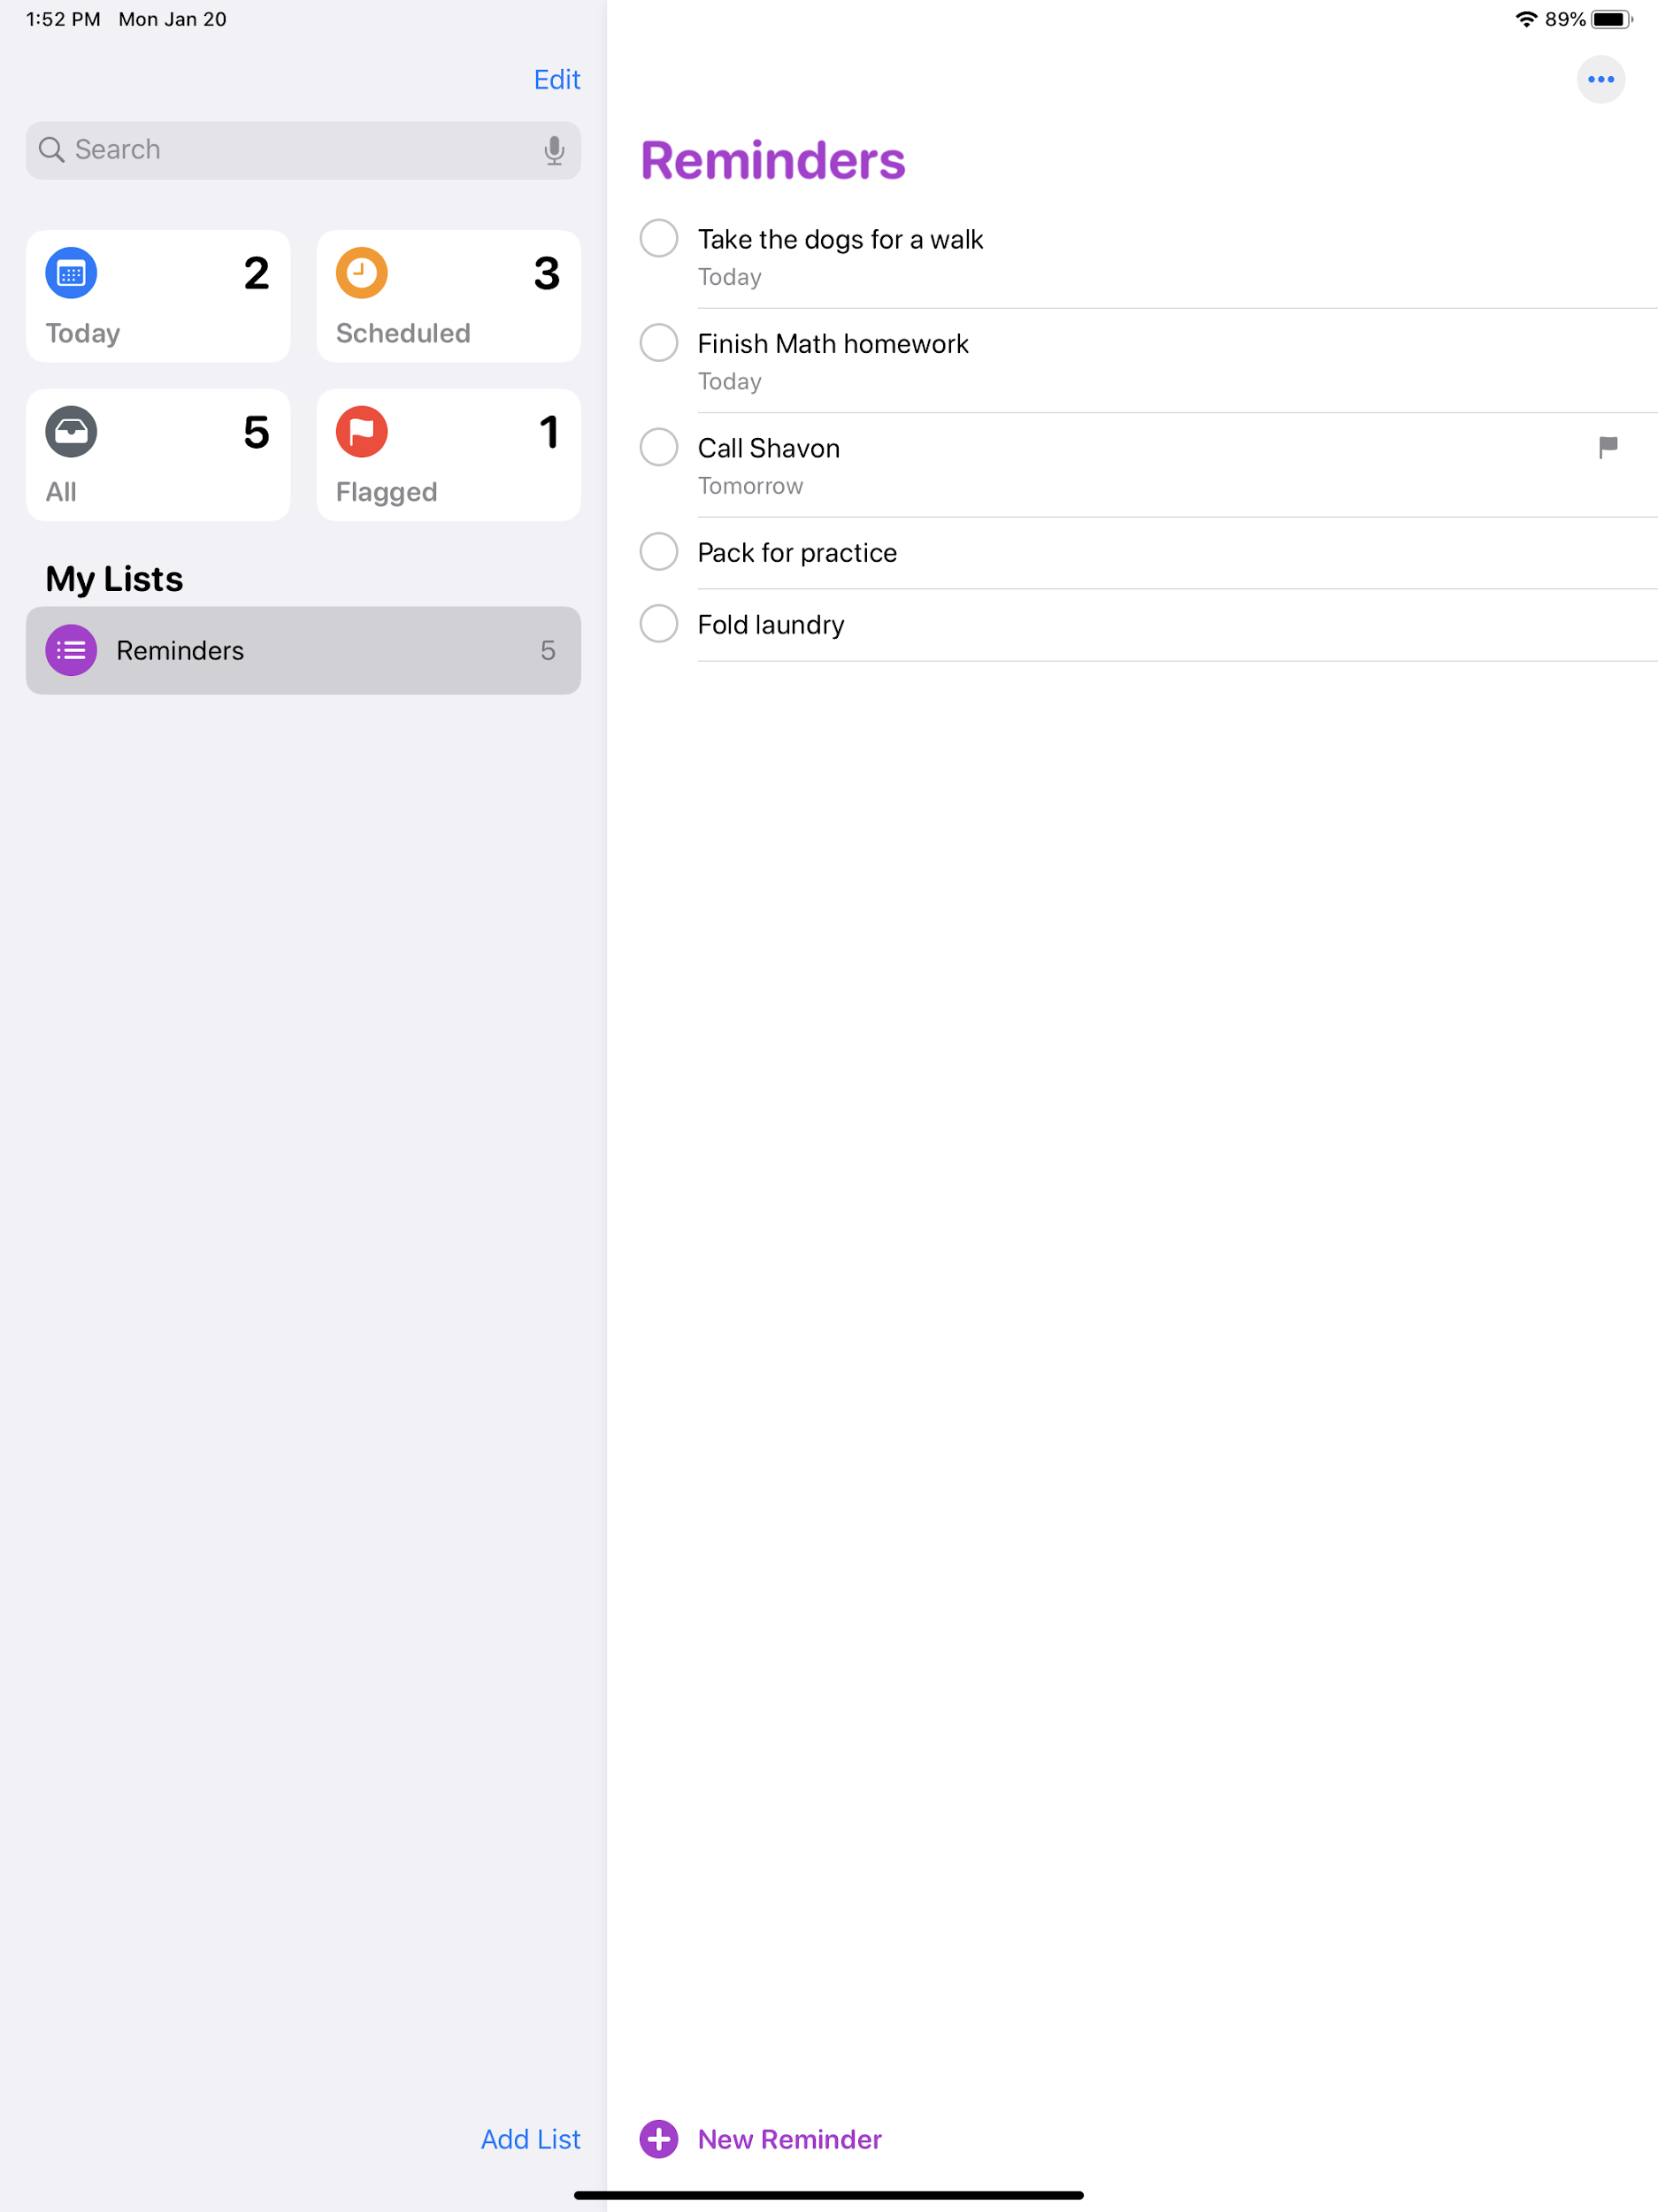
Warm-Up
I’m going to open up the Reminder app. For one minute, I’m going to click/tap through the application as I normally would while using it.
Partner A will be the “user” tapping and scrolling through the app (that’s me!)
Partner B will count the number of times the application DOES something (i.e. loads content, responds to a tap by showing a different screen or new content, etc.) (that’s you!)

Slide 63
Takeaways
Every action in a mobile app is powered by functions written by mobile app developers! For example, a function (or many functions) perform its job when you…
Click a button and see something happen
See new data load (your account page, someone else’s profile page, detail of an image, etc.)
And many many more!

Slide 64
What is a function?
A function is code that has a specific job.
It does not do anything unless it is asked
It can be a simple task (i.e. add 2 numbers together)
It can be very complex (i.e find the standard deviation of 1 million numbers)
As an example, we will write instructions for a robot to walk a dog.

Slide 65
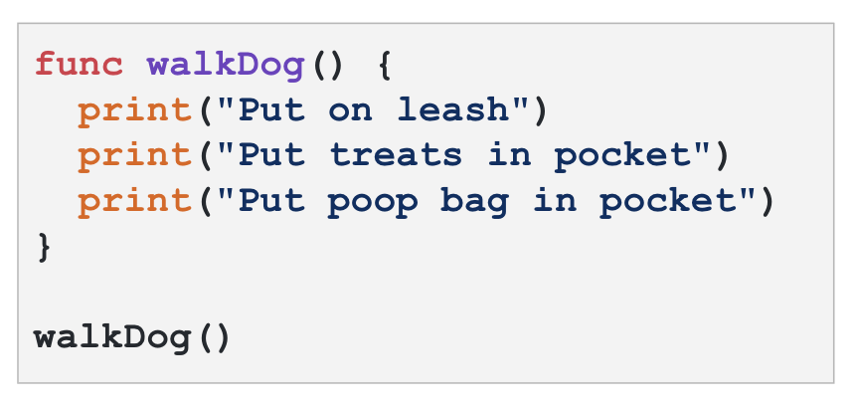

Writing a Function
declaration
code block
call

Slide 66
Declaring a Function
use the keyword func followed by the function name and ()
followed by {}
The name of the function should describe what it does.
If the name consists of more than one word, use camelCase.

Slide 67
Code Block
the code block defines the function’s job between {}

Slide 68
Calling a function
call the function with the function name followed by ()
When you call a function, you're asking the computer to execute the instructions that were defined earlier. It’s like saying, "Okay, let's do this now!"

Slide 69
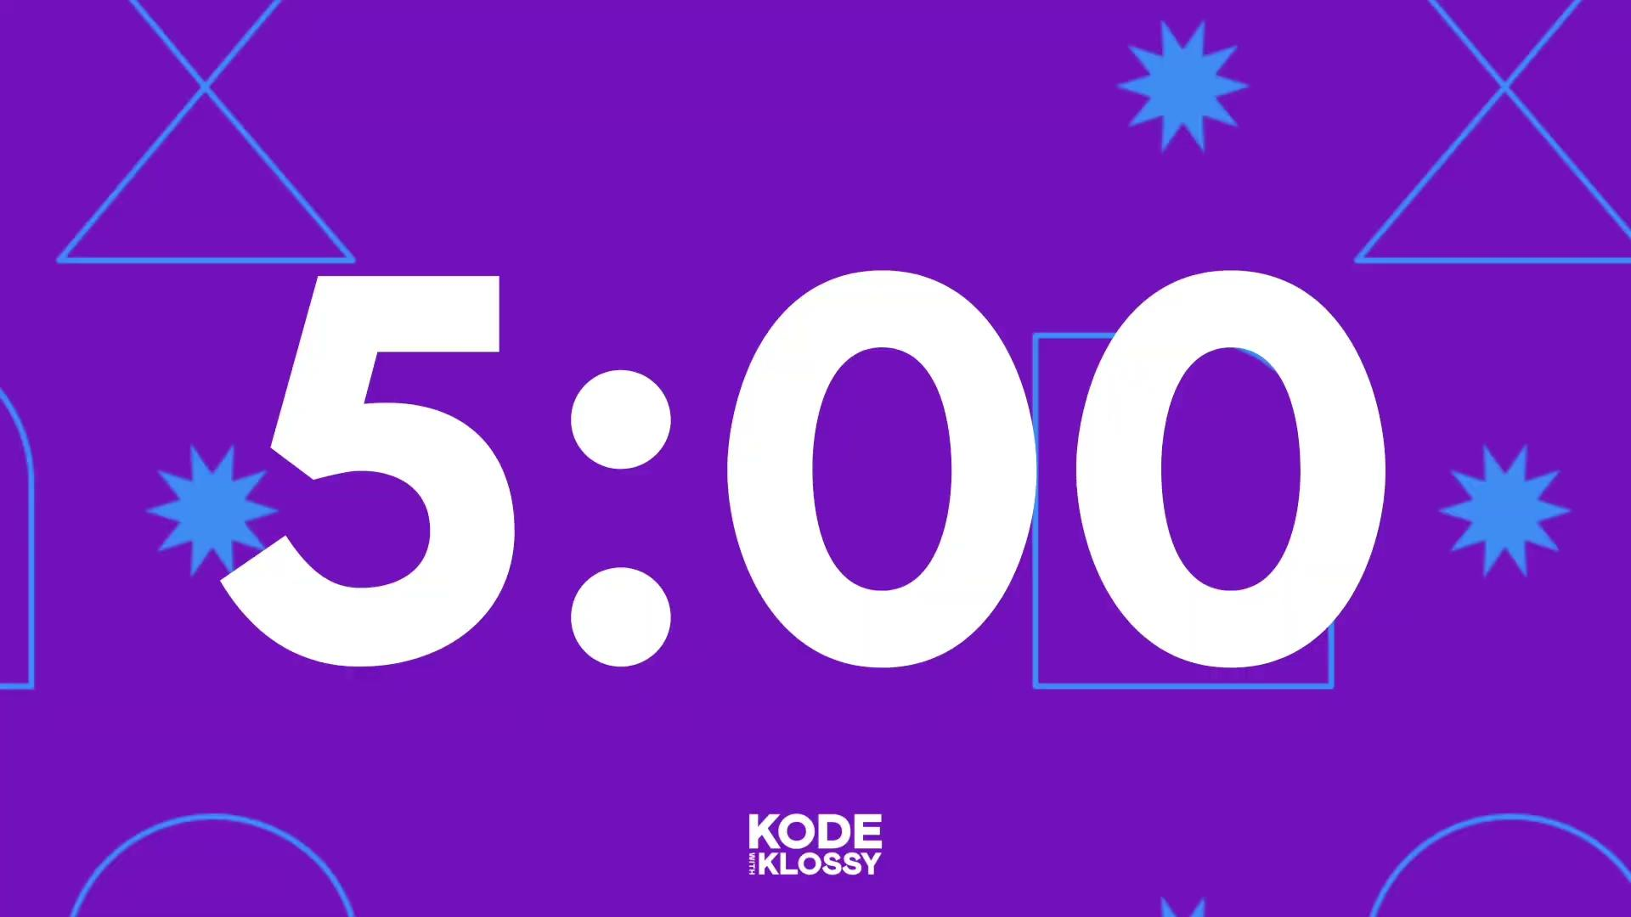
Try-It | Declaring & Calling a Function
Declare and call a function named sayHello.
Write 2-4 print statements in it, saying whatever you'd like.
Verify that it is running successfully by checking the console for the sentences.
Declare and call a function named sayGoodbye.
Write 2-4 print statements in it, saying whatever you'd like.
Verify that it is running successfully by checking the console for the sentences.
🌶️🌶️ Medium Challenge: Did your sayHello sentences print before or after your sayGoodbye sentences? Why? Try changing something in your code so that the order is reversed!

Slide 70
Parameters and Arguments
declare parameters in the parentheses after the function name
func walkDog(numberOfDogs: Int) {
print("Put on \(numberOfDogs) leashes")
print("Put \(numberOfDogs) treats in pocket")
print("Put \(numberOfDogs) poop bags in pocket")
}
walkDog(numberOfDogs: 2)
//=> Put on 2 leashes
//=> Put 2 treats in pocket
//=> Put 2 poop bags in pocket
pass in arguments in the parentheses when the function is called

Slide 71
What are Parameters?
Parameters allow data to be passed into a function, making it more dynamic.
The syntax for declaring a parameter is very similar to declaring a variable. The parameters are local variables that can only be referenced inside the function.
func walkDog(numberOfDogs: Int) {
print("Put on \(numberOfDogs) leashes")
print("Put \(numberOfDogs) treats in pocket")
print("Put \(numberOfDogs) poop bags in pocket")
}

Slide 72
What are Arguments?
Arguments are the specific values passed into a function when it is called.
The arguments replace the corresponding parameters in the function.
func walkDog(numberOfDogs: Int) {
print("Put on \(numberOfDogs) leashes")
print("Put \(numberOfDogs) treats in pocket")
print("Put \(numberOfDogs) poop bags in pocket")
}
walkDog(numberOfDogs: 2)
walkDog(numberOfDogs: 5)

Slide 73
Local Variables
Parameters act as local variables within a function and can only be used inside the function, similar to the local variables we saw with for-in loops.
This means different functions can have local variables with the same name.
Parameters can also be used for calculations, like in the example below.
func timeToWalk(numberOfDogs : Int) {
let totalMinutes = numberOfDogs * 15
print("You will walk a total of \(totalMinutes) minutes.")
}
timeToWalk(numberOfDogs: 3) //-> You will walk a total of 45 minutes.
timeToWalk(numberOfDogs: 7) //-> You will walk a total of 105 minutes.

Slide 74
Parameters and Arguments Review
How would you explain the difference between parameters and arguments in your own words?
func readingTime(numberOfPages: Int, minutesPerPage: Int) {
let totalMinutes = numberOfPages * minutesPerPage
print("It will take about \(totalMinutes) minutes to read \(numberOfPages) pages.")
}
readingTime(numberOfPages: 50, minutesPerPage: 2)
//-> "It will take about 100 minutes to read 50 pages."
readingTime(numberOfPages: 120, minutesPerPage: 1)
//-> "It will take about 120 minutes to read 120 pages."

Slide 75
Parameters and Arguments Review
How would you explain the difference between parameters and arguments in your own words?
parameters are the placeholders
func readingTime(numberOfPages: Int, minutesPerPage: Int) {
let totalMinutes = numberOfPages * minutesPerPage
print("It will take about \(totalMinutes) minutes to read \(numberOfPages) pages.")
}
readingTime(numberOfPages: 50, minutesPerPage: 2)
//-> "It will take about 100 minutes to read 50 pages."
readingTime(numberOfPages: 120, minutesPerPage: 1)
//-> "It will take about 120 minutes to read 120 pages."
arguments are the actual values

Slide 76
Try-It | Parameters and Arguments
🌶️ Mild Challenge: Write a function that will take 1 argument (when called) that is a number. The function will print the sum of this number and 5. Make sure to name your function something related to its job.
🌶️🌶️ Medium Challenge: Write a function that will take 2 arguments (when called) that are both numbers. The function will print the sum of these two numbers. Make sure to name your function something related to its job.
🌶️🌶️🌶️ Spicy Challenge: Write a function that will take 3 arguments (when called) that are all numbers. The function will print the sum of the first two numbers multiplied by the third number. Name your function something related to its job.

Slide 77
Return Values
func timeToWalk(numberOfDogs : Int) {
let totalMinutes = numberOfDogs * 15
print("You will walk a total of \(totalMinutes) minutes.")
}
timeToWalk(numberOfDogs: 3) //-> You will walk a total of 45 minutes.
Returning a value makes a function more flexible by allowing the result to be reused, stored, or processed further, rather than just displaying it.
func timeToWalk(numberOfDogs : Int) -> Int {
let totalMinutes = numberOfDogs * 15
return totalMinutes
}
var totalTime = timeToWalk(numberOfDogs: 3)
print("You will walk a total of \(totalTime) minutes.")
//-> You will walk a total of 45 minutes.
print("I spent \(totalTime)) minutes walking today!")
//-> I spent 45 minutes walking today!

Slide 78
How to Implement Return Values
func timeToWalk(numberOfDogs : Int) -> Int {
let totalMinutes = numberOfDogs * 15
return totalMinutes
}
var totalTime = timeToWalk(numberOfDogs: 3)
print("You will walk a total of \(totalTime) minutes.")
//-> You will walk a total of 45 minutes.
print("I spent \(totalTime)) minutes walking today!")
//-> I spent 45 minutes walking today!

Slide 79
More About return
a function can only have one return statement
func timeToWalk(numberOfDogs : Int) -> Int {
let totalMinutes = numberOfDogs * 15
return totalMinutes
print("You will walk a total of \(totalMinutes) minutes.")
}
var totalTime = timeToWalk(numberOfDogs: 3)
print("You will walk a total of \(totalTime) minutes.")
//-> You will walk a total of 45 minutes.
print("I spent \(totalTime)) minutes walking today!")
//-> I spent 45 minutes walking today!
code after the return statement will never be executed

Slide 80
Explore & Discuss
Imagine you’re a dog walker and you’ve created these two functions to calculate the total time you’ll spend walking and the money you’ll make based on the number of dogs. Explain each line of code using as much technical vocabulary as possible!
var dogs = 3
func timeToWalk(numberOfDogs : Int) -> Int {
let totalMinutes = numberOfDogs * 15
return totalMinutes
}
func makeMoney(numberOfDogs : Int) -> Int {
let totalPaid = numberOfDogs * 30
return totalPaid
}
var totalTime = timeToWalk(numberOfDogs: dogs)
var totalDollars = makeMoney(numberOfDogs: dogs)
print("You walked \(dogs) dogs for a total of \(totalTime) minutes. You made $\(totalDollars) today!")
//=> You walked 3 dogs for a total of 45 minutes. You made $90 today!

Slide 81
Discussion Takeaways
declares a new variable to store the number of dogs
var dogs = 3
func timeToWalk(numberOfDogs : Int) -> Int {
let totalMinutes = numberOfDogs * 15
return totalMinutes
}
func makeMoney(numberOfDogs : Int) -> Int {
let totalPaid = numberOfDogs * 30
return totalPaid
}
var totalTime = timeToWalk(numberOfDogs: dogs)
var totalDollars = makeMoney(numberOfDogs: dogs)
print("You walked \(dogs) dogs for a total of \(totalTime) minutes. You made $\(totalDollars) today!")
//=> You walked 3 dogs for a total of 45 minutes. You made $90 today!

Slide 82
Discussion Takeaways
var dogs = 3
func timeToWalk(numberOfDogs : Int) -> Int {
let totalMinutes = numberOfDogs * 15
return totalMinutes
}
func makeMoney(numberOfDogs : Int) -> Int {
let totalPaid = numberOfDogs * 30
return totalPaid
}
var totalTime = timeToWalk(numberOfDogs: dogs)
var totalDollars = makeMoney(numberOfDogs: dogs)
print("You walked \(dogs) dogs for a total of \(totalTime) minutes. You made $\(totalDollars) today!")
//=> You walked 3 dogs for a total of 45 minutes. You made $90 today!
declares a function

Slide 83
Discussion Takeaways
states that we expect to receive an integer value when this function is called and it will be stored in a local variable called numberOfDogs
var dogs = 3
func timeToWalk(numberOfDogs : Int) -> Int {
let totalMinutes = numberOfDogs * 15
return totalMinutes
}
func makeMoney(numberOfDogs : Int) -> Int {
let totalPaid = numberOfDogs * 30
return totalPaid
}
var totalTime = timeToWalk(numberOfDogs: dogs)
var totalDollars = makeMoney(numberOfDogs: dogs)
print("You walked \(dogs) dogs for a total of \(totalTime) minutes. You made $\(totalDollars) today!")
//=> You walked 3 dogs for a total of 45 minutes. You made $90 today!

Slide 84
Discussion Takeaways
var dogs = 3
func timeToWalk(numberOfDogs : Int) -> Int {
let totalMinutes = numberOfDogs * 15
return totalMinutes
}
func makeMoney(numberOfDogs : Int) -> Int {
let totalPaid = numberOfDogs * 30
return totalPaid
}
var totalTime = timeToWalk(numberOfDogs: dogs)
var totalDollars = makeMoney(numberOfDogs: dogs)
print("You walked \(dogs) dogs for a total of \(totalTime) minutes. You made $\(totalDollars) today!")
//=> You walked 3 dogs for a total of 45 minutes. You made $90 today!
declares that we plan to return an integer when the function is called

Slide 85
Discussion Takeaways
var dogs = 3
func timeToWalk(numberOfDogs : Int) -> Int {
let totalMinutes = numberOfDogs * 15
return totalMinutes
}
func makeMoney(numberOfDogs : Int) -> Int {
let totalPaid = numberOfDogs * 30
return totalPaid
}
var totalTime = timeToWalk(numberOfDogs: dogs)
var totalDollars = makeMoney(numberOfDogs: dogs)
print("You walked \(dogs) dogs for a total of \(totalTime) minutes. You made $\(totalDollars) today!")
//=> You walked 3 dogs for a total of 45 minutes. You made $90 today!
declares the totalMinutes and totalPaid local constants to store the result of the multiplication

Slide 86
Discussion Takeaways
var dogs = 3
func timeToWalk(numberOfDogs : Int) -> Int {
let totalMinutes = numberOfDogs * 15
return totalMinutes
}
func makeMoney(numberOfDogs : Int) -> Int {
let totalPaid = numberOfDogs * 30
return totalPaid
}
var totalTime = timeToWalk(numberOfDogs: dogs)
var totalDollars = makeMoney(numberOfDogs: dogs)
print("You walked \(dogs) dogs for a total of \(totalTime) minutes. You made $\(totalDollars) today!")
//=> You walked 3 dogs for a total of 45 minutes. You made $90 today!
returns the totalMinutes and totalPaid local constants

Slide 87
Discussion Takeaways
declare two new variables totalTime and totalDollars to store the return values of calling the functions with dogs as the argument
var dogs = 3
func timeToWalk(numberOfDogs : Int) -> Int {
let totalMinutes = numberOfDogs * 15
return totalMinutes
}
func makeMoney(numberOfDogs : Int) -> Int {
let totalPaid = numberOfDogs * 30
return totalPaid
}
var totalTime = timeToWalk(numberOfDogs: dogs)
var totalDollars = makeMoney(numberOfDogs: dogs)
print("You walked \(dogs) dogs for a total of \(totalTime) minutes. You made $\(totalDollars) today!")
//=> You walked 3 dogs for a total of 45 minutes. You made $90 today!

Slide 88
Discussion Takeaways
prints a sentence using with all three variables using interpolation
var dogs = 3
func timeToWalk(numberOfDogs : Int) -> Int {
let totalMinutes = numberOfDogs * 15
return totalMinutes
}
func makeMoney(numberOfDogs : Int) -> Int {
let totalPaid = numberOfDogs * 30
return totalPaid
}
var totalTime = timeToWalk(numberOfDogs: dogs)
var totalDollars = makeMoney(numberOfDogs: dogs)
print("You walked \(dogs) dogs for a total of \(totalTime) minutes. You made $\(totalDollars) today!")
//=> You walked 3 dogs for a total of 45 minutes. You made $90 today!

Slide 89
Closures

Slide 90
Closures
Similar to functions, closures are self-contained blocks of code that can be passed around and executed later.
Unlike functions, closures can be unnamed, making them concise and flexible.
Functions are essentially named closures!
{ (parameters) -> returnType in
//code
}

Slide 91
Why do we need closures?
The .sorted() method returns the array sorted in alphabetical order.
But what if we wanted to sort the array in reverse alphabetical order?
let names = ["Chloe", "Ana", "Destiny", "Bao", "Ellen"]
print(names.sorted())
//-> ["Ana", "Bao", "Chloe", "Destiny", "Ellen"]

Slide 92
Why do we need closures?
let names = ["Chloe", "Ana", "Destiny", "Bao", "Ellen"]
print(names.sorted())
//-> ["Ana", "Bao", "Chloe", "Destiny", "Ellen"]
The .sorted() method returns the array sorted in alphabetical order.
But what if we wanted to sort the array in reverse alphabetical order?
The sorted(by:) method is used to sort an array based on a custom comparison, but you must define the comparison with a closure!

Slide 93
Defining a Closure
This is a closure named backward that takes two parameters (s1 and s2), both of type String, and returns a Boolean value: true or false.
The expression s1 > s2 means "is s1 lexicographically greater than s2?" This comparison evaluates to true if s1 is "larger" (in terms of alphabetical order) than s2.
let backward = {(s1: String, s2: String) -> Bool in return s1 > s2}

Slide 94
Sorting Process
The array is sorted using the comparison closure by repeatedly comparing elements and swapping them if needed.
let names = ["Chloe", "Ana", "Destiny", "Bao", "Ellen"]
let backward = {(s1: String, s2: String) -> Bool in return s1 > s2}
print(names.sorted(by: backward))
//-> ["Ellen", "Destiny", "Chloe", "Bao", "Ana"]
returns true if the strings are already in reverse alphabetical order and returns false if they need to swap

Slide 95
Sorting Process
let names = ["Chloe", "Ana", "Destiny", "Bao", "Ellen"]
let backward = {(s1: String, s2: String) -> Bool in return s1 > s2}
print(names.sorted(by: backward))
//-> ["Ellen", "Destiny", "Chloe", "Bao", "Ana"]
// backward("Chloe", "Ana") -> "Chloe" > "Ana" -> true
//-> "Chloe" remains before "Ana"
// backward("Ana", "Destiny") -> "Ana" > "Destiny" -> false
//-> updated list: ["Chloe", "Destiny", "Ana", "Bao", "Ellen"]
// sorted(by:) completes this comparison through the end of the array, then goes back to the beginning and continues checking and swapping until the array is fully sorted!

Slide 96
var viralHits = ["Run the World (Girls)", "Die For You (Remix)", "Flowers", "Truth Hurts", "No Scrubs", "Pretty Girl Rock"]
let backward = {(s1: String, s2: String) -> Bool in return s1 > s2}
var reversedHits = viralHits.sorted(by: backward)
// -> ["Truth Hurts", "Run the World (Girls)", "Pretty Girl Rock", "No Scrubs", "Flowers", "Die For You (Remix)"]

Slide 97

var viralHits = ["Run the World (Girls)", "Die For You (Remix)", "Flowers", "Truth Hurts", "No Scrubs", "Pretty Girl Rock"]
let backward = {(s1: String, s2: String) -> Bool in return s1 > s2}
var reversedHits = viralHits.sorted(by: backward)
// -> ["Truth Hurts", "Run the World (Girls)", "Pretty Girl Rock", "No Scrubs", "Flowers", "Die For You (Remix)"]
var viralHits = ["Run the World (Girls)", "Die For You (Remix)", "Flowers", "Truth Hurts", "No Scrubs", "Pretty Girl Rock"]
var reversedHits = viralHits.sorted(by: {(s1: String, s2: String)
-> Bool in return s1 > s2})
// -> ["Truth Hurts", "Run the World (Girls)", "Pretty Girl Rock", "No Scrubs", "Flowers", "Die For You (Remix)"]
closure expression
(unnamed closure)

Slide 98
Try-It | Closures
Create a named closure that accepts two integer parameters and returns their sum. Reference this backward example to help you get started!
Use this array of song titles for this challenge:
Use the filter method and a closure to filter the array so that it only includes songs that start with the letter "A".
let backward = {(s1: String, s2: String) -> Bool in return s1 > s2}
print(backward("Chloe", "Ana")) //-> false
var songTitles = ["All Too Well", "Not Like Us", "As It Was"]

Slide 99
Syntactic Sugar
Syntactic sugar refers to language features that make code easier to read and write by providing a more concise or expressive syntax.
It doesn't add new functionality—it just gives you a different, often simpler way to accomplish the same task.

Slide 100
var reversedHits = viralHits.sorted(by: {(s1: String, s2: String) -> Bool in return
s1 > s2
})

Slide 101
var reversedHits = viralHits.sorted(by: {(s1: String, s2: String) -> Bool in return
s1 > s2
})
var reversedHits = viralHits.sorted(by: { s1, s2 in return
s1 > s2
})

Slide 102
var reversedHits = viralHits.sorted(by: {(s1: String, s2: String) -> Bool in return
s1 > s2
})
var reversedHits = viralHits.sorted(by: { s1, s2 in return
s1 > s2
})
var reversedHits = viralHits.sorted(by: { s1, s2 in s1 > s2 })

Slide 103
var reversedHits = viralHits.sorted(by: {(s1: String, s2: String) -> Bool in return
s1 > s2
})
var reversedHits = viralHits.sorted(by: { s1, s2 in return
s1 > s2
})
var reversedHits = viralHits.sorted(by: { s1, s2 in s1 > s2 })
var reversedHits = viralHits.sorted(by: { $0 > $1 })

Slide 104
var reversedHits = viralHits.sorted(by: {(s1: String, s2: String) -> Bool in return
s1 > s2
})
var reversedHits = viralHits.sorted(by: { s1, s2 in return
s1 > s2
})
var reversedHits = viralHits.sorted(by: { s1, s2 in s1 > s2 })
var reversedHits = viralHits.sorted(by: { $0 > $1 })
var reversedHits = viralHits.sorted { $0 > $1 }

Slide 105
Try-It | Syntactic Sugar
Test out the syntactic sugar language features we learned on the names array. Use a print() statement after each line to verify that the output is the same.
let names = ["Chloe", "Ana", "Destiny", "Bao", "Ellen"]
var reversedNames = names.sorted(by: {(s1: String, s2: String) -> Bool in return s1 > s2 })
var reversedNames = names.sorted(by: { s1, s2 in return s1 > s2 })
var reversedNames = names.sorted(by: { s1, s2 in s1 > s2 })
var reversedNames = names.sorted(by: { $0 > $1 })
var reversedNames = names.sorted { $0 > $1 }

Slide 106
Do I need to memorize these?!
Absolutely not! Your main goals right now are to:
understand the concept of closures
recognize them in code in the future

Slide 107
Understanding Optionals
Another common array method is first(where:), which returns the first element in an array that matches a given condition.
In the example below, we call the first(where:) method on the viralHits array and the first song title that is less than 10 characters long is returned.
var viralHits = ["Run the World (Girls)", "Die For You (Remix)", "Flowers", "Truth Hurts", "No Scrubs"]
let firstShortHit = viralHits.first(where: { $0.count < 10})
print(firstShortHit!)
//-> Flowers

Slide 108
Understanding Optionals
It's possible that none of the songs on our viralHits playlist were less than 10 characters long.
For this reason, the .first(where:) method returns an optional value, which basically means that it either returns a value if it finds a match or it returns nil if it doesn't.

Slide 109
Understanding Optionals
nil essentially means "no value."
In Swift, we use nil for both clarity and type safety. Swift prevents you from accidentally using nil values unless you handle them properly, preventing runtime errors!

Slide 110
Force Unwrapping
var viralHits = ["Run the World (Girls)", "Die For You (Remix)", "Flowers", "Truth Hurts", "No Scrubs"]
let firstShortHit = viralHits.first(where: { $0.count < 10})
print(firstShortHit!)
//-> Flowers

Slide 111
Optional Binding
var viralHits = ["Die For You (Remix)", "Flowers", "Truth Hurts", "No Scrubs", "Pretty Girl Rock"]
if let firstShortHit = viralHits.first(where: {$0.count < 10}) {
print("The first short song title is: \(firstShortHit)")
} else {
print("No song titles are less than 10 characters long.")
}

Slide 112
Practice
Throughout camp, we will write a lot of functions and closures! They will have different jobs, and some will look quite different from ours today, but you’ve got a great foundation.
Reference the practice and extensions in the lesson for details!

Slide 113
Extensions

Slide 114
Writing Your Own Function: Part 1
Brainstorm another task you might repeat often enough that a function would be helpful! In your notebook, write out the small steps it would take to complete the task.
Declare and call the function with an empty code block. This is a good step to take to make sure there are no errors.
To make 100% sure you are calling it correctly, write a print statement in the code block and make sure that the output appears in your console.
Now, write a print statement for each of the commands you wrote down in your notebook. Are they all printing out as expected?
What arguments could you provide your function to make it dynamic?

Slide 115
Writing Your Own Function: Part 2
Modify your function to take an argument of any data type!
Call the function multiple times with different arguments.
If your function includes a print statement, change it to a return statement. Define the return value’s data type in the function declaration and use the return keyword.
Call your function a few times, passing in different arguments each time. Always predict the output before running the code and ensure the function dynamically calculates and returns a value based on the argument.
What is another argument that could be passed in your function? Try it out! Not sure what the syntax looks like? You got this. Remember, strong developers are strong Googlers, so feel free to look for examples online.

Slide 116
Incorporating Conditional Statements
You can include conditional statements in the code block of a function. For example, thinking back to our dog walking robot:
if numberOfDogs is 1, it will print out one set of directions
func walkDog(numberofDogs: Int) {
if numberOfDogs == 1 {
print("Put on \(numberOfDogs) leash")
print("Put \(numberOfDogs) treat in pocket")
print("Put \(numberOfDogs) poop bag in pocket")
} else {
print("Put on \(numberOfDogs) leashes")
print("Put \(numberOfDogs) treats in pocket")
print("Put \(numberOfDogs) poop bags in pocket")
}
}
if numberOfDogs is not 1, it will print out another set

Slide 117
Try-It | Logic Inside a Function
Write a function that:
takes one argument called gradeLevel
prints out "You are in elementary school" or "You are in middle school", etc. based on the grade level passed in
Write another function that:
takes in a number called dogAge and multiplies the number by 7
prints out a sentence telling the dog how old it is in human years

Slide 118
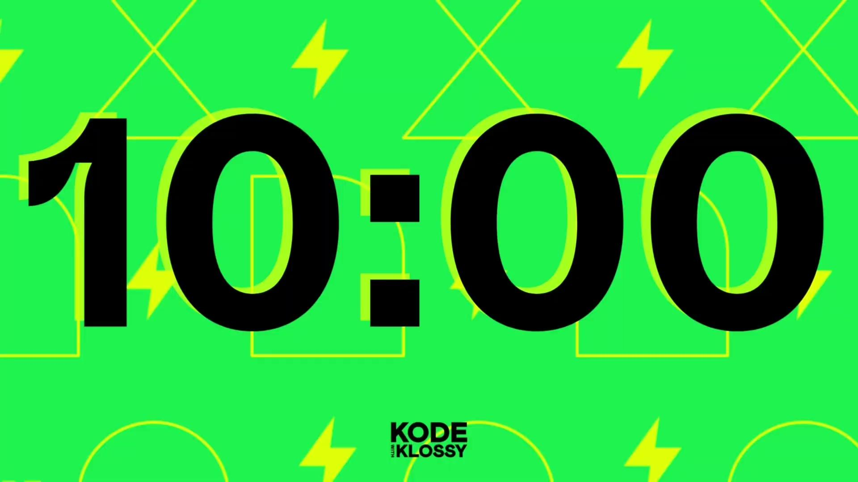
Try-It | Putting It All Together
🌶️ Mild Challenge: Declare a function called findLongestWord. It should iterate over an array of strings and return the string with the greatest number of characters. If there is a tie for the greatest number of characters, return the last one in the array.
🌶️🌶️ Medium Challenge: Write a function that takes in one argument, an array of Integers. The array must have at least 3 elements. All numbers except for one of them will be either even or odd. Your job is to return the one number that is the exception. Below are some example inputs and outputs. Make sure your function works on them all.
Input: [1, 3, 5, 6], Output: 6
Input: [10, 15, 20, 30, 40, 50], Output: 15
Input: [19, 5, 42, 1, 77], Output: 42
🌶️🌶️🌶️ Spicy Challenge: Write a function that takes in one argument, a string. If the string is "happy", output a randomly selected sentence about being happy. If the string is "ok", output a randomly selected sentence about being ok. If the string is "sad", output a randomly selected sentence to cheer someone up. You will need to use a function, conditional, multiple arrays, and generate a random number.

Slide 119
Lunch

Slide 120
Welcome back from lunch!
We’ll get started in just a bit: we’d love to see you camera on!

Slide 121
SwiftUI: Views, Stacks & Modifiers

Slide 122
Navigate Xcode and understand the purpose of its various windows and areas
Create and run a project in Xcode
Understand the purpose and functionality of SwiftUI views
Use stacks and views to design user interfaces and customize their appearance using modifiers

Slide 123
Struct
View
Modifier
Stacks
Spacer
Padding

Slide 124
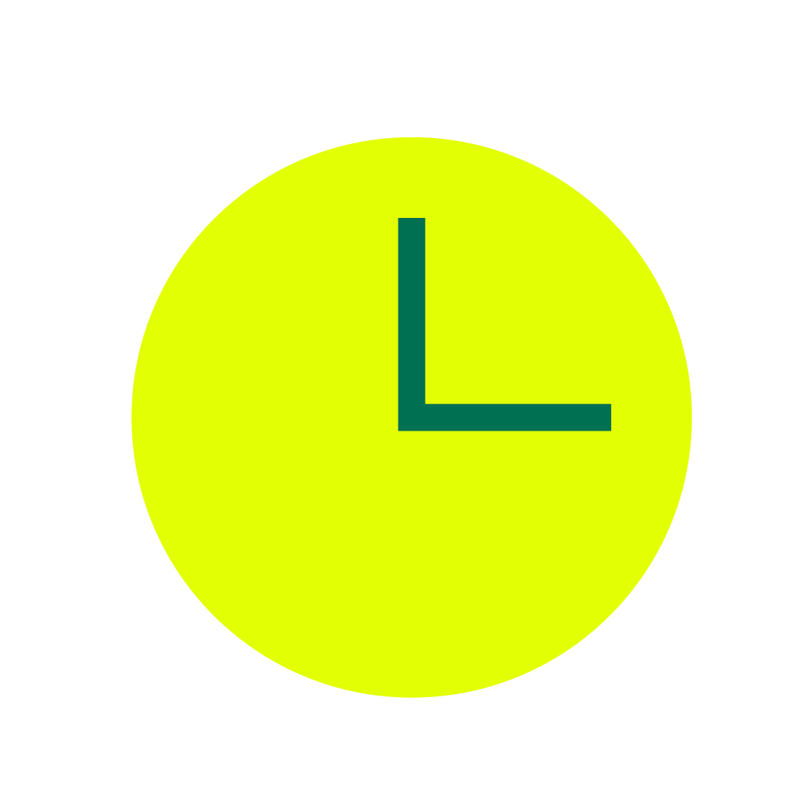

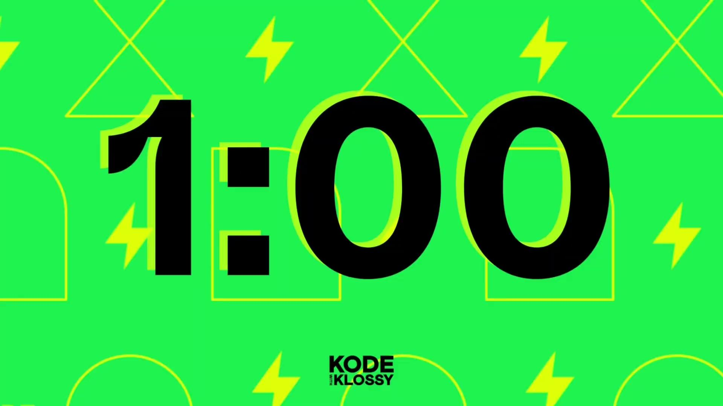
Warm-Up
1
mins
mins
min
Take 1 minute to write down all the steps to drawing a smiley face. Be as specific as you can. Afterward, your instructors will attempt to draw the smiley face following your exact instructions.

Slide 125

Who knew drawing a smiley face could be so complex?!
‹#›

Slide 126
Declarative vs. Imperative Programming
Declarative Programming
Imperative Programming
Focused on WHAT the program should achieve.
Example: Asking a friend to draw a mountain scene, but the method is up to them!
Focused on HOW to achieve the result.
Example: Following Bob Ross step-by-step to paint a mountain scene.

Slide 127
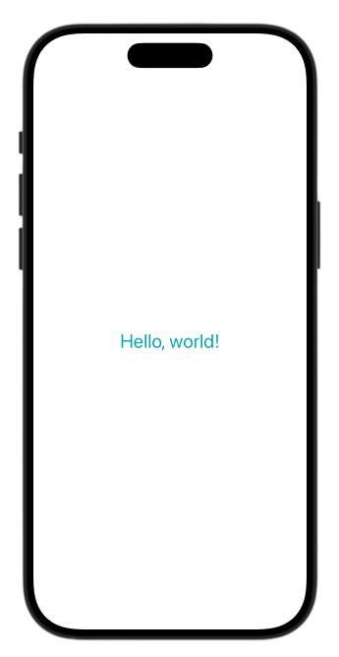
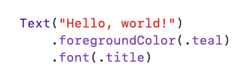

SwiftUI
SwiftUI is a declarative framework for building iOS apps. Instead of writing step-by-step instructions, you describe what your app should look like, and SwiftUI takes care of the rest!

Slide 128

XCode Projects
Xcode Projects allow us to build mobile applications!
A lot more than writing code goes into building an iOS app, but we can do it all in Xcode.
Xcode has many panels, buttons, and options that can feel intimidating at first! We’ll take it one step at a time.

Slide 129
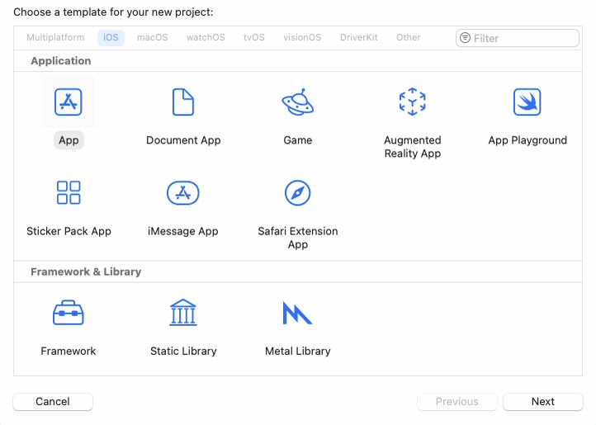
Creating an Xcode Project
Launch Xcode.
Double-click on Create New Project.
Select iOS and App, then click Next.
Choose these options for your project:
Product Name: MyFirstApp
Team: Leave empty
Organization Identifier: kwk
Interface: SwiftUI
Language: Swift
Testing System: None
Storage: None
Click next and choose where to save your project!

Slide 130
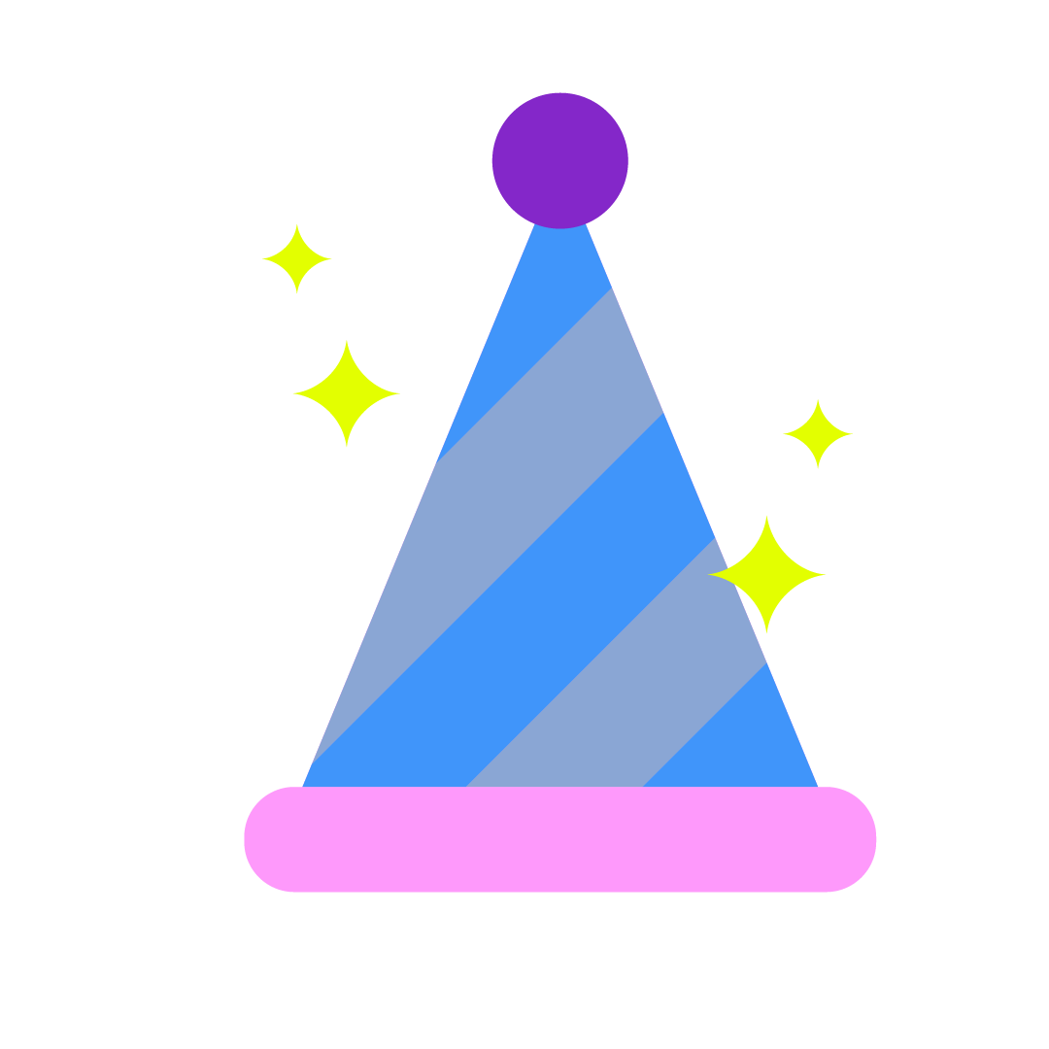
Yay!!! You created your first Xcode project!

Slide 131
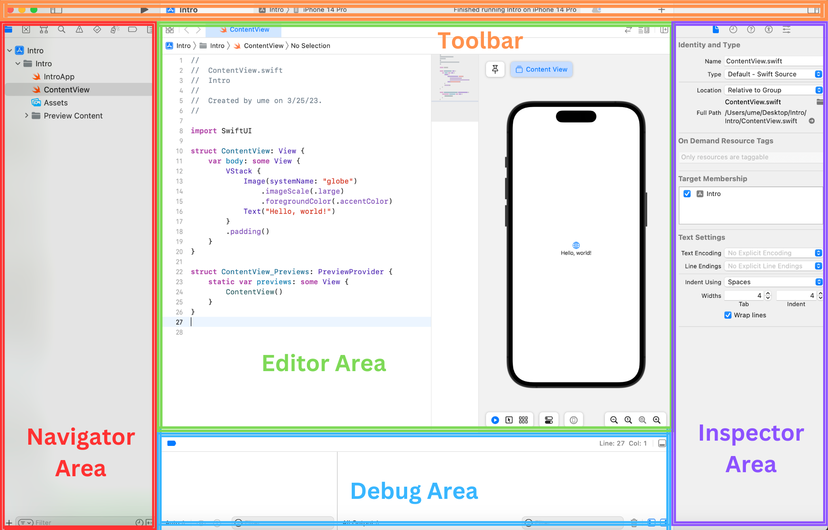

Slide 132
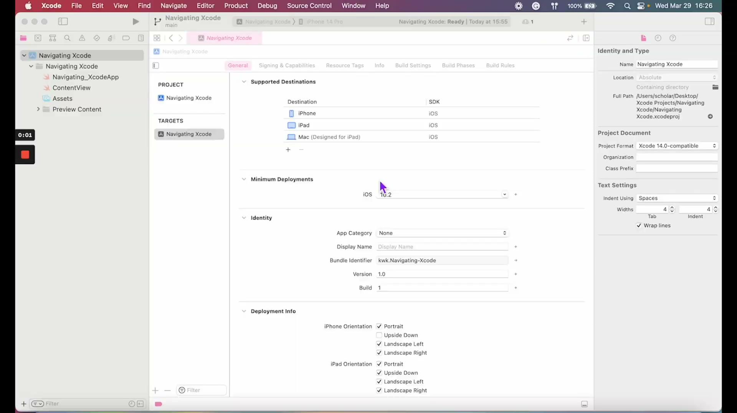

Slide 133

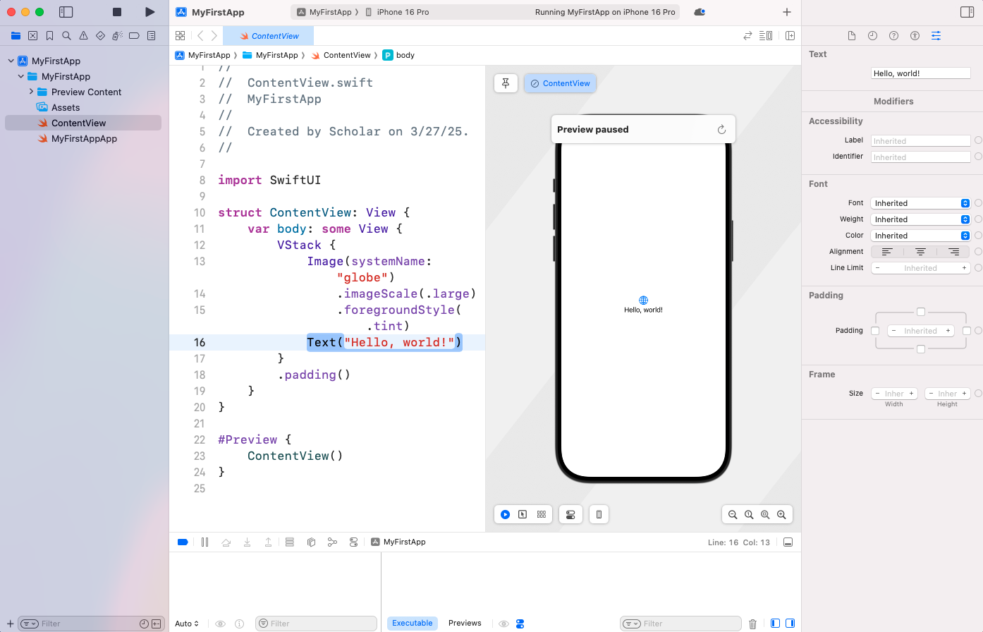


Navigator Area
Project Navigator → View all project files
Swift Files → code for your app
Assets → store images and app icons
Issue Navigator → See errors, warnings & crashes
Opens automatically if your app crashes

Slide 134
Editor Area
Use this area to customize and edit your app! The code shown here changes based on the file you select. For example, when the ContentView file is selected:
Edit code for the user interface on the left
See a live preview of your app on the right

Slide 135


Inspector Area
Attributes → Edit properties (font, size, color, etc.) by selecting a specific view in the editor
Quick Help → Access Apple’s Developer Documentation

Slide 136
Debug Area
This is similar to the console area in your Xcode playgrounds. When you run your code, this area will show:
Print statements
Error messages
You can also open/collapse this area as you like by clicking on the bar and dragging.

Slide 137
Toolbar
You can find the window control buttons and buttons to toggle the Navigator and Inspector panels in the Toolbar.
Use the play button to build and run your app on a simulator! The status bar in the center of the Toolbar shows the current status of the project build process.

Slide 138
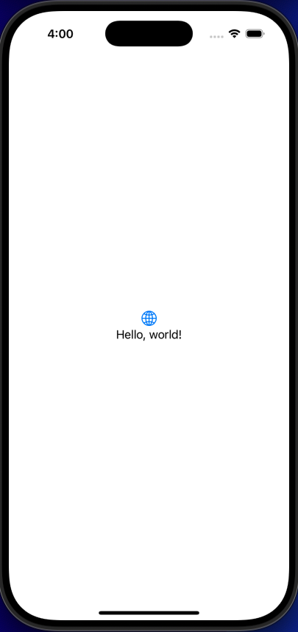

Simulator
The Xcode simulator uses a lot of computer power, which can make everything run more slowly. It's best to stop the simulator while you're working on your code. You can always start it again when you're ready to test your app!

Slide 139
Scavenger Hunt!

Slide 140
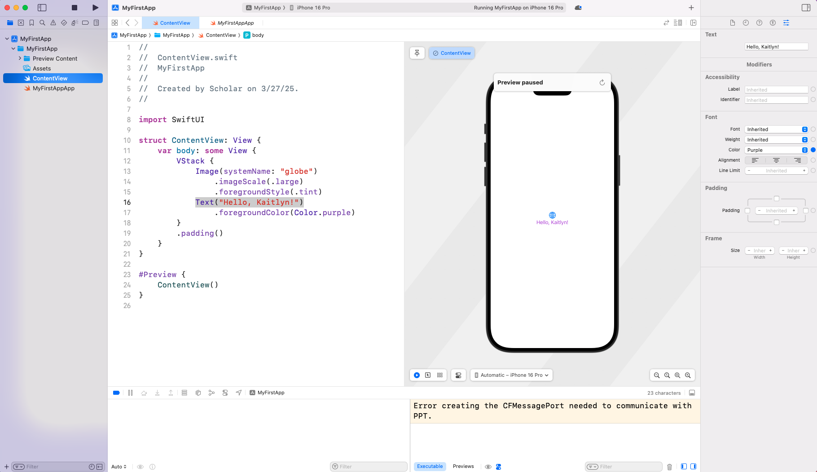
toggle the inspector
start/stop the simulator
view the status
toggle the navigator
change the text color
edit the text
toggle the debug area

Slide 141
See, think, wonder!
import SwiftUI
struct ContentView: View {
var body: some View {
VStack {
Image(systemName: "globe")
.imageScale(.large)
.foregroundColor(.accentColor)
Text("Hello, world!")
}
.padding()
}
}
#Preview {
ContentView()
}
Looking at the ContentView file, answer the following questions about the code with your group:
What do you see?
What do you think?
What do you wonder?
What looks familiar based on what we know about Swift and what looks different?

Slide 142
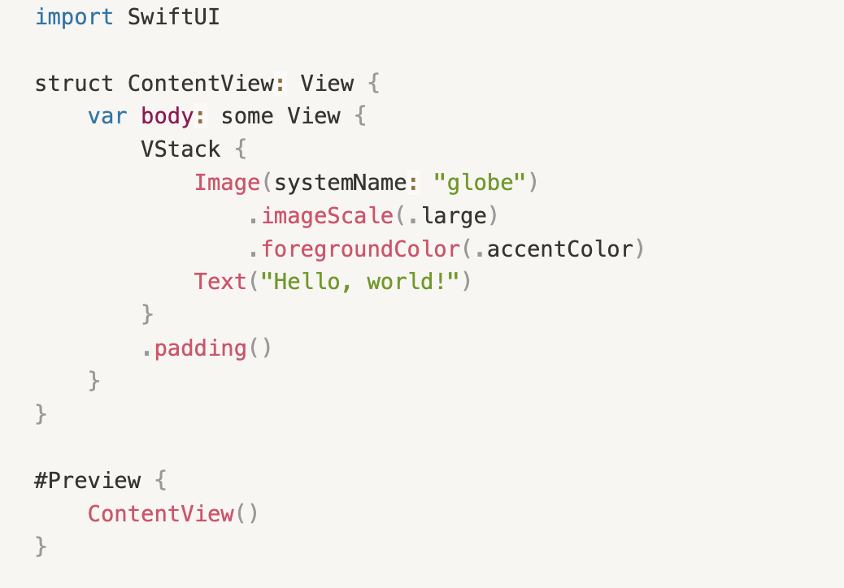
See, think, wonder!
import SwiftUI // Imports SwiftUI framework
struct ContentView: View {
var body: some View {
// defines the content and layout
//
//
//
//
//
//
}
}
#Preview { // Enables live preview
ContentView()
}
The basic structure of a SwiftUI file:
Imports the SwiftUI framework to build interfaces
Defines a new structure called ContentView
Includes the body property, which defines the content and layout of the view
Enables live previews

Slide 143
Structures and Views
Structures are a data type in Swift that can store multiple values.
Defined with the keyword struct
Think of it as a container that holds all of the code that makes up our UI
Views come from SwiftUI.
Require a body property that returns some View
Inside its body property, we define what the content of the view will be
import SwiftUI
struct ContentView: View {
var body: some View {
VStack {
Image(systemName: "globe")
.imageScale(.large)
.foregroundColor(.accentColor)
Text("Hello, world!")
}
.padding()
}
}
#Preview {
ContentView()
}

Slide 144
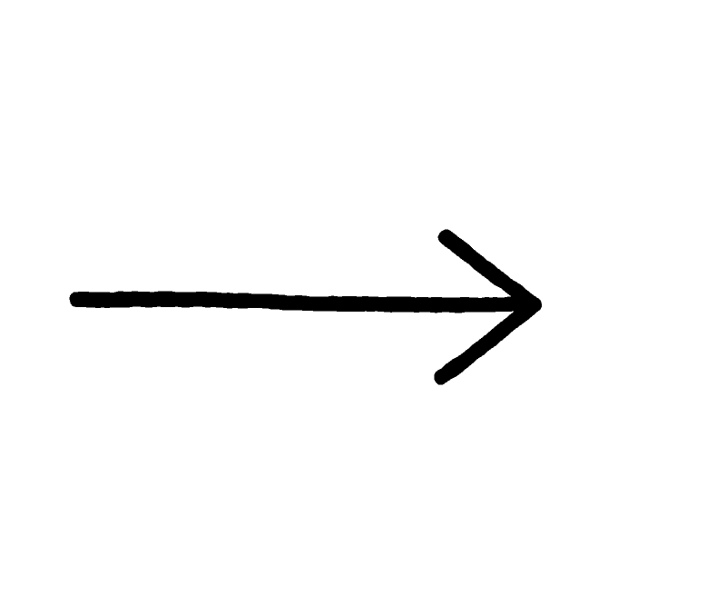
Views
It’s important to note that in SwiftUI, all text, buttons, images (and more!) are called views.
A view is any visual element that appears on the screen.
import SwiftUI
struct ContentView: View {
var body: some View {
VStack {
Image(systemName: "globe")
.imageScale(.large)
.foregroundColor(.accentColor)
Text("Hello, world!")
}
.padding()
}
}
#Preview {
ContentView()
}

Slide 145
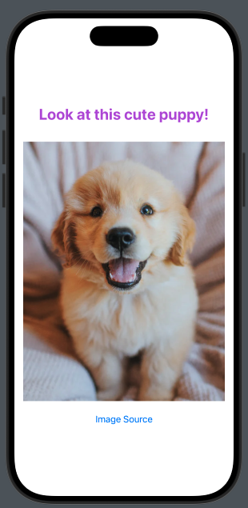
Creating the UI
Let’s practice building a simple UI using the SwiftUI framework!
Our user interface will look like the one shown here. It will have custom text, an image of your choice and a link to the image source.

Slide 146
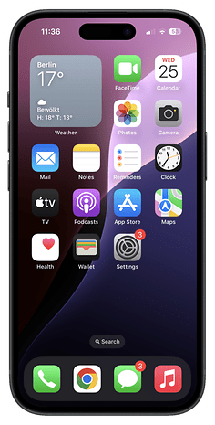
Add Home Screen Icons
Finished early?
Check out the extension in the lesson! After reading through the tutorial, you’ll be able to create a custom home screen icon for your app.

Slide 147
You created your first customized UI! Make sure to take a moment to reflect and feel proud of this huge accomplishment!

Slide 148
Swift UI practice

Slide 149
Do you need a break?

Slide 150
Views & Modifiers

Slide 151
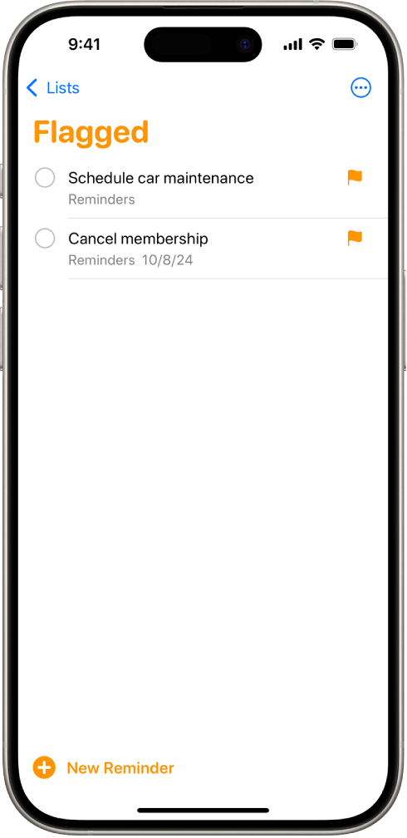
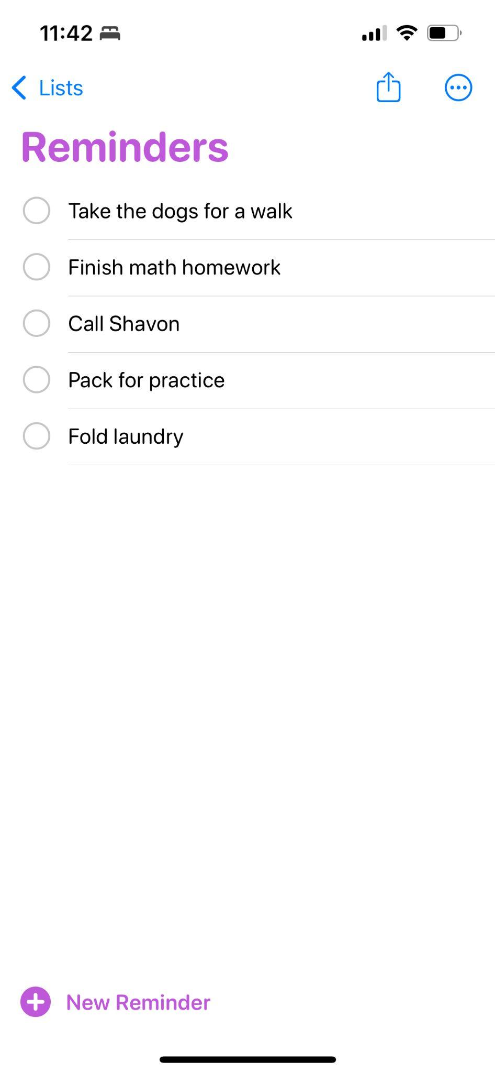
SwiftUI Views
A view is any visual element that appears on the screen. A view is often composed of other views, forming a view hierarchy.
A view that contains another view is called a parent view, while the contained views are called child views (or subviews). A parent view can have multiple child views.

Slide 152
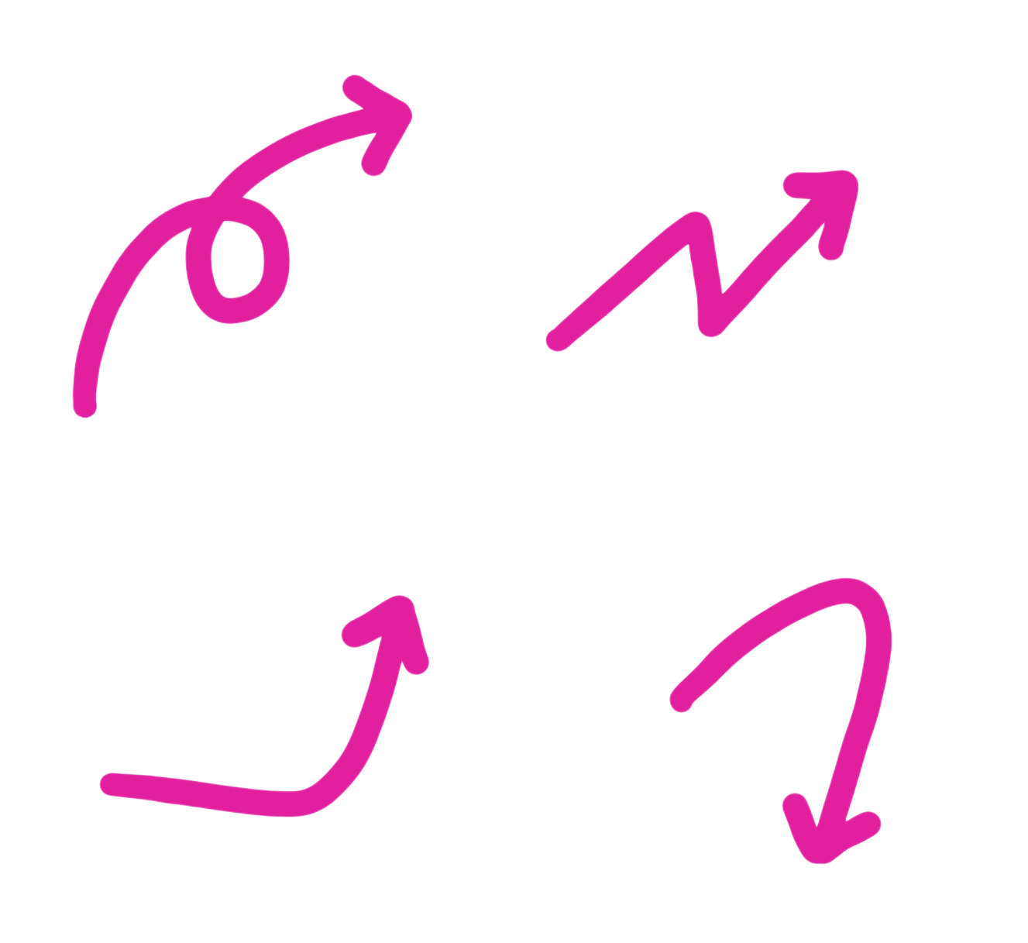
SwiftUI Views
A view is any visual element that appears on the screen. A view is often composed of other views, forming a view hierarchy.
A view that contains another view is called a parent view, while the contained views are called child views (or subviews). A parent view can have multiple child views.
list view
(parent)

Slide 153
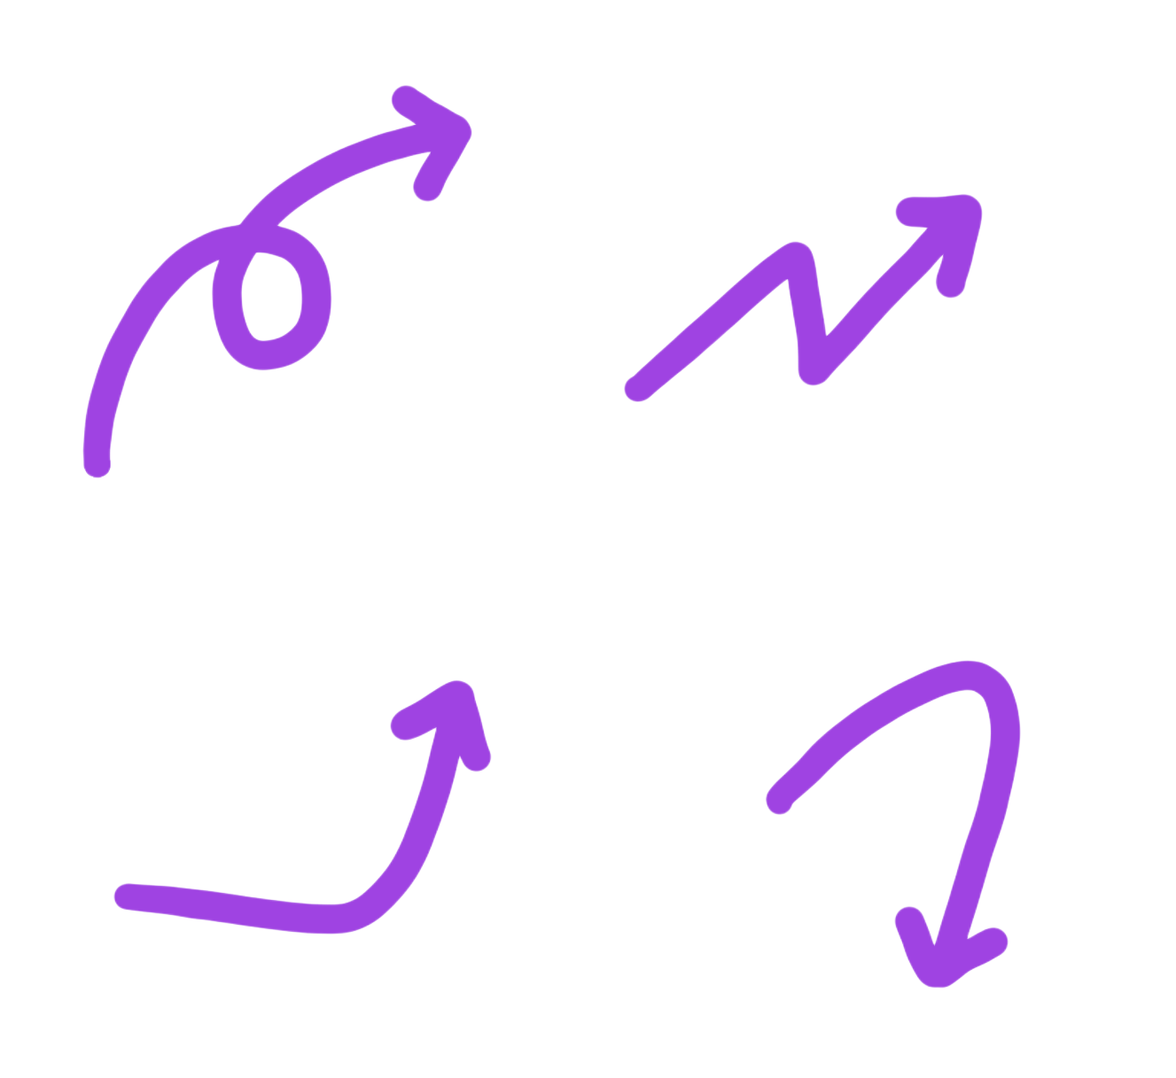
SwiftUI Views
A view is any visual element that appears on the screen. A view is often composed of other views, forming a view hierarchy.
A view that contains another view is called a parent view, while the contained views are called child views (or subviews). A parent view can have multiple child views.
list view
(parent)
text views
(child)

Slide 154
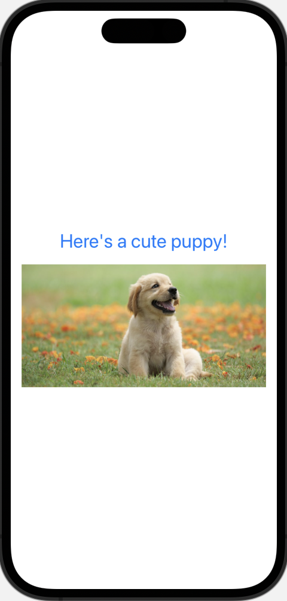
SwiftUI Modifiers
Modifiers allow us to customize and design views on our UI.
We used modifiers when to customize the color of the text view and size of the image view in our first app.
Modifiers can be added via the attributes inspector, or simply typed directly in the editor.
A view can have many modifiers.
Modifiers can be added via the attributes inspector, or simply coded in.
struct ContentView: View {
var body: some View {
VStack {
Text("Look at this cute puppy!")
.font(.title)
.fontWeight(.bold)
.foregroundColor(.purple)
Image("cute-puppy")
.resizable(resizingMode: .stretch)
.aspectRatio(contentMode: .fit)
.padding()
}
}
}

Slide 155
SwiftUI Modifiers
Modifiers allow us to customize and design views on our UI.
We used modifiers when to customize the color of the text view and size of the image view in our first app.
Modifiers can be added via the attributes inspector, or simply typed directly in the editor.
A view can have many modifiers.
Modifiers can be added via the attributes inspector, or simply coded in.
struct ContentView: View {
var body: some View {
VStack {
Text("Look at this cute puppy!")
.font(.title)
.fontWeight(.bold)
.foregroundColor(.purple)
Image("cute-puppy")
.resizable(resizingMode: .stretch)
.aspectRatio(contentMode: .fit)
.padding()
}
}
}

Slide 156
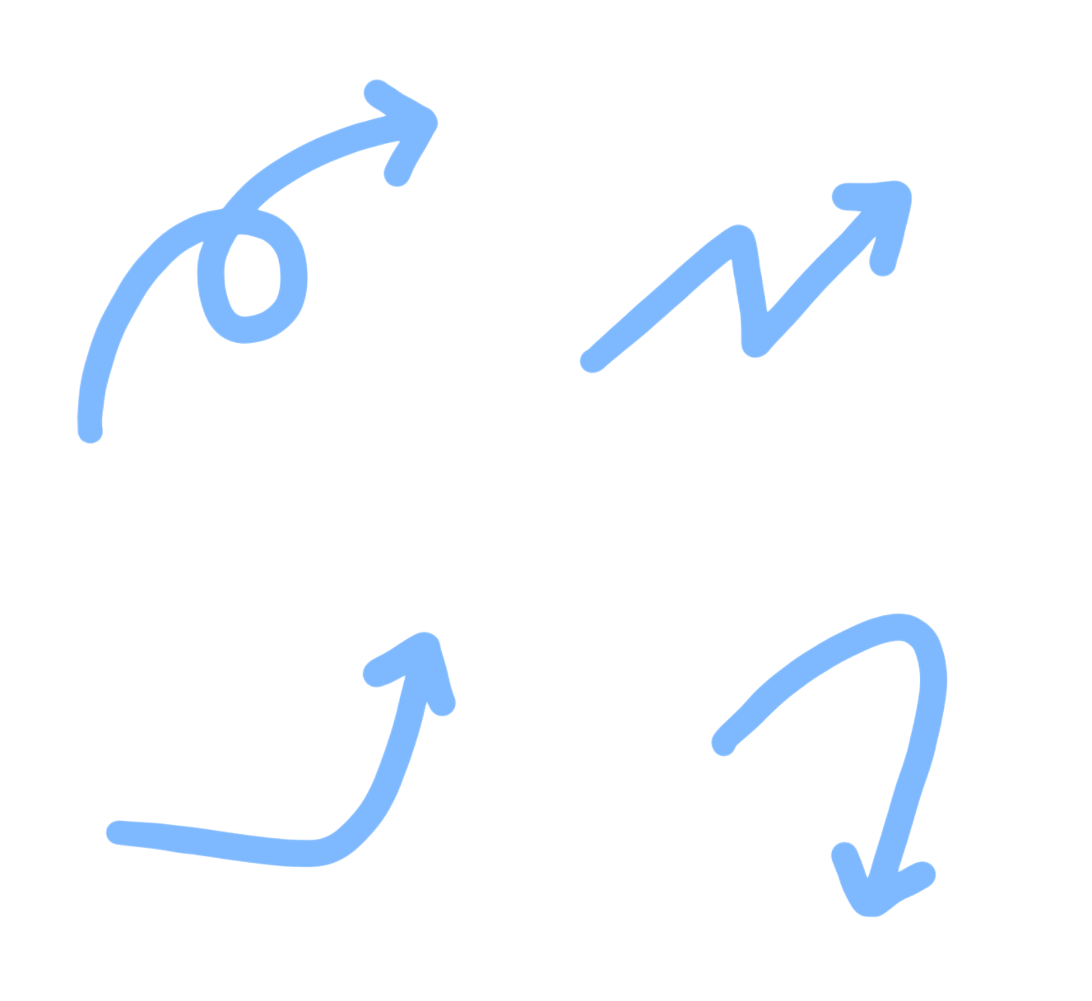
SwiftUI Stacks
A stack view groups views together to create a specific layout in an app.
Stacks can be added by opening the library and dragging them to the code, or coded in directly.
In our cute puppy app, we used a VStack to organize views vertically on our UI.

Slide 157
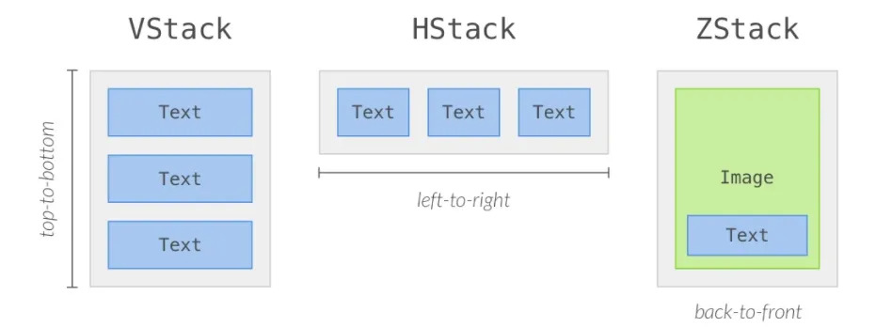
SwiftUI Stacks

Slide 158
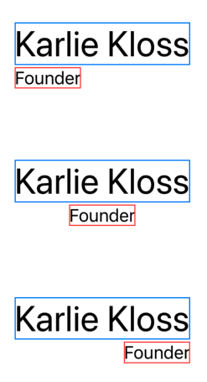
VStack Alignment Properties
Customize the alignment property by assigning it to .leading, .center, or .trailing. The alignment property of a VStack applies to the horizontal alignment of the views.
VStack(alignment: .leading) { ... }
VStack(alignment: .center) { ... }
VStack(alignment: .trailing) { ... }

Slide 159
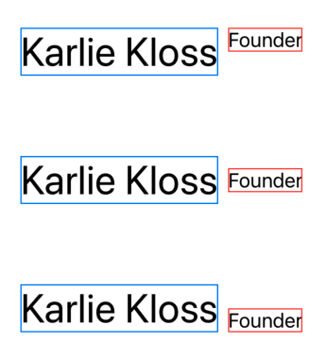
HStack Alignment Properties
The alignment property of an HStack applies to the vertical alignment of the views within the HStack.
HStack(alignment: .top) { ... }
HStack(alignment: .center) { ... }
HStack(alignment: .bottom) { ... }

Slide 160
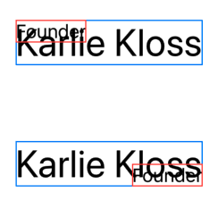
ZStack Alignment Properties
While we will typically keep the default alignment for a ZStack, it is possible to customize alignment by using a combination horizontal and vertical alignments either together or separately.
ZStack(alignment: .topLeading) { ... }
ZStack(alignment: Alignment(horizontal: .trailing, vertical: .bottom)) { ... }

Slide 161
Spacing in Stacks

Slide 162
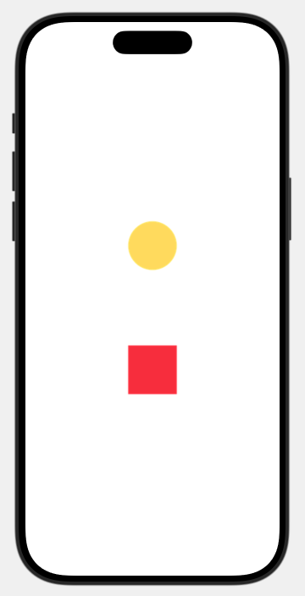
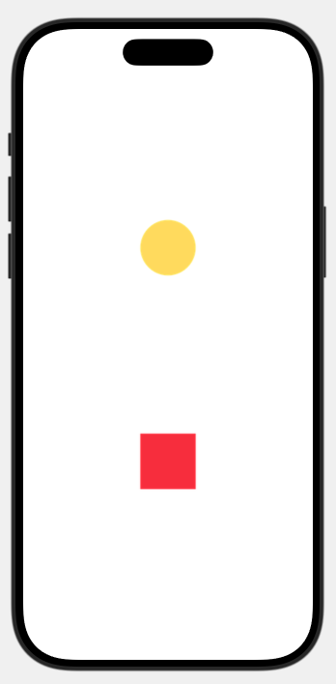
spacing Property
VStack(spacing: 200) {
Image("circle")
Image("square")
}
VStack(spacing: 100) {
Image("circle")
Image("square")
}

Slide 163
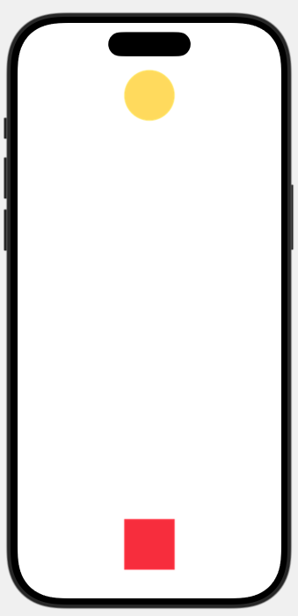
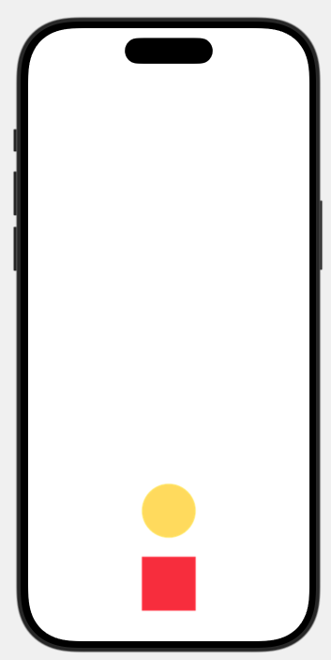
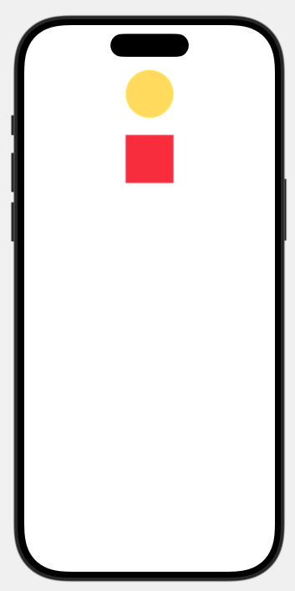
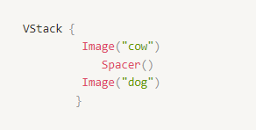
Spacer View
For example, in the code block below, the Spacer() pushes each image to the edge of the VStack because it is placed between the two image views.
VStack {
Image("circle")
Spacer()
Image("square")
}

Slide 164
Spacer View
For example, in the code block below, the Spacer() pushes each image to the edge of the VStack because it is placed between the two image views.
VStack {
Spacer()
Image("circle")
Image("square")
}
VStack {
Image("circle")
Spacer()
Image("square")
}
VStack {
Image("circle")
Image("square")
Spacer()
}

Slide 165
What’s the difference between the spacing property and the Spacer view?

Slide 166
spacing Property vs. Spacer View
VStack {
Image("circle")
Spacer()
Image("square")
}
VStack(spacing: 100) {
Image("circle")
Image("square")
}

Slide 167
Try-It | Stacks
mins
mins
Complete the following in your MyFirstApp XCode project.
Change the vertical stack to an HStack and then a ZStack. Change it back to a VStack once you’ve identified how the stack changes the layout.
Use a Spacer view to push the image and the link to the bottom of the screen. Note: You may need to adjust the size of the images to see the effects of this.
Specify a value for the alignment property of the VStack. Try all three values (.leading, .center, and .trailing) and identify the changes in the Interactive Preview.
Delete the Spacer view and add the spacing property to the VStack. This should add some space between the child views.

Slide 168
Building an App with Nested Stacks

Slide 169
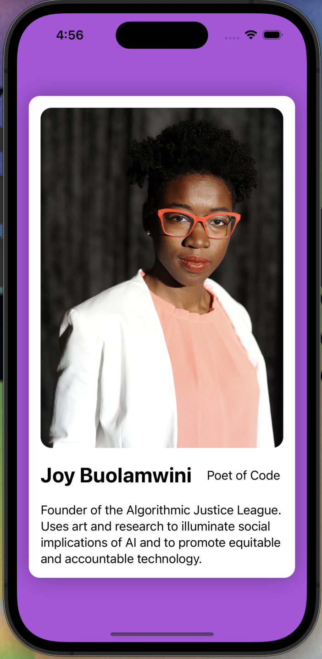
Think About It
Often developers will combine stack views to create more interesting layouts. This is also referred to as building nested views.
Before we start building, consider the following questions:
What stacks do you imagine we will need?
What views will be contained in each?

Slide 170
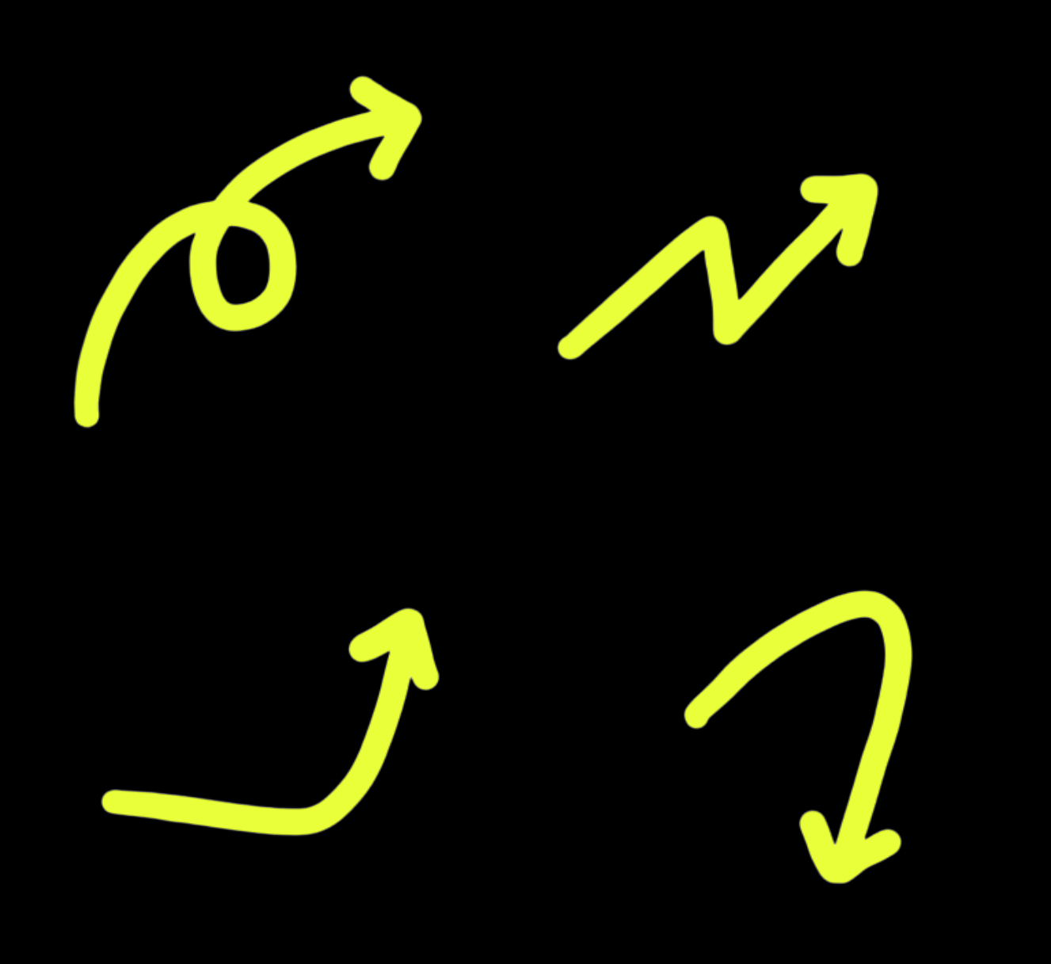
Think About It
We will use all three stacks!
ZStack
VStack
HStack
ZStack
VStack
HStack

Slide 171
Getting Started
Let’s get started building this app!
Create a new Xcode project called STEMStars.
Delete the boilerplate code in the body property.
Be careful! Don’t delete the two closing brackets for the struct and body!

Slide 172
App Structure
struct ContentView: View {
var body: some View {
ZStack {
Color()
VStack {
Image()
HStack {
Text()
Spacer()
Text()
}
Text()
}
}
}
}
The final structure of your app should look similar to this! We’ve left out the modifiers and the details for each view, so that you can compare you app structure to this code.
The most common mistakes are often related to nesting the views properly. Keep the indentation of your code consistent to avoid these errors and improve readability!

Slide 173
▶️ 🎉 Your app is finished! Run your app and take a few moments to reflect and feel proud of everything you have accomplished during this lesson.

Slide 174
Reflection
10
mins
mins
mins
Take 10 minutes to synthesize your learnings and create a one-pager that you can reference later on with important takeaways from this lesson (pictures encouraged!).

Slide 175
Practice
Reference the practice in the lesson for details!

Slide 176
Show & Tell
5
mins
mins
mins
Independently prepare for Show & Tell
Small groups of 2-3
Introduce yourself
Go over the app you created
Name what you are most proud of!
Others should share GLOWS!!!
Switch

Slide 177
Brain Break

Slide 178
Culture of Tech 1 (Part 2):
Kode With Klossy & Me

Slide 179
Closing Circle

Slide 180
End-Of-Day Reminders
‼️ Submit Your Artifacts in Your House ‼️
Be sure to screenshot your code and preview of your app you made into the designated thread in your House channel!
🕠 Office Hours 🕡
Tonight: Mishu, Christine, and Amulya will be hosting from 6pm-7pm
😴💻 Night Hack 💻😴
Arrays & Loops Practice + Extensions + Spicy Challenges
Functions & Closures Practice + Extensions + Spicy Challenges
Continue updating your STEMStars App if you’d like

Slide 181

About Speaker Series
An opportunity to connect with leaders in the world of tech
Speakers work in various industries at different intersections of tech & creativity
Kode With Klossy CEO & an alum will interview the speaker
Q&A with the audience
Attended by every member in Kode With Klossy camps during this time - both virtual and in-person camps

Slide 182
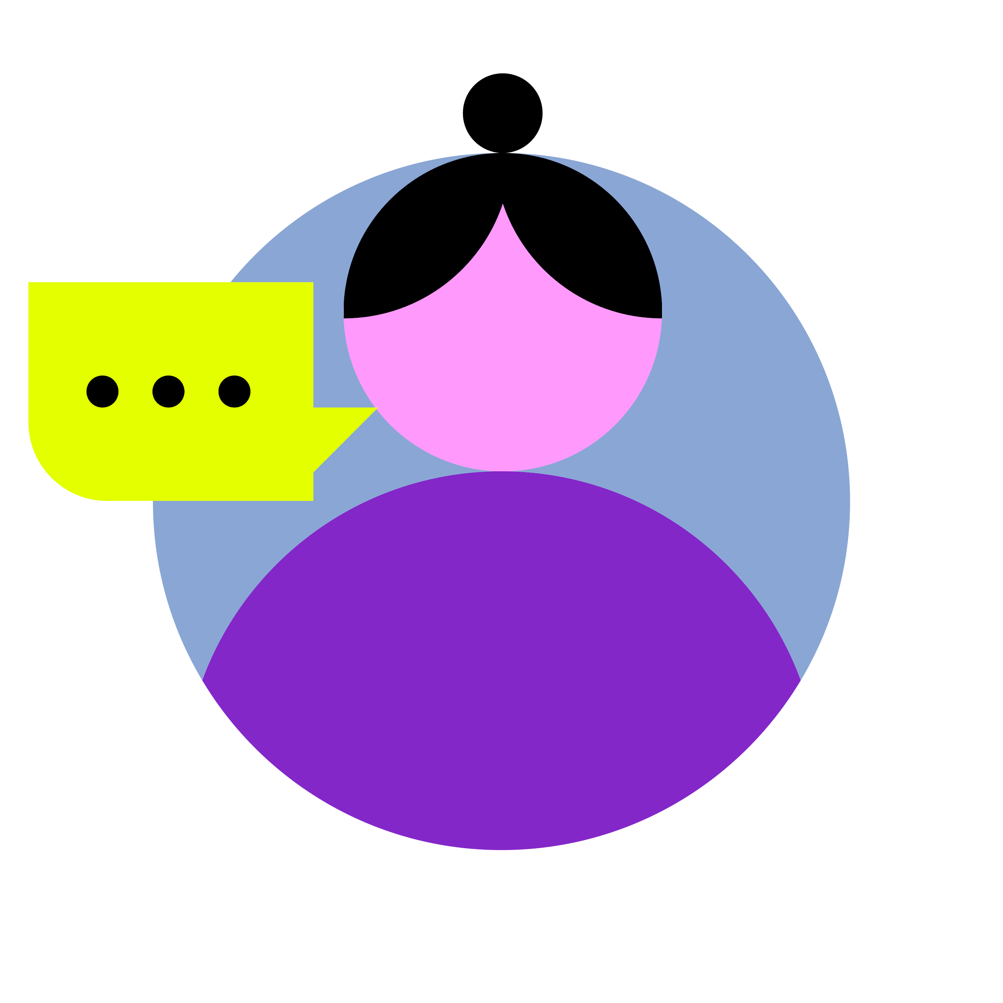
Speaker Series Expectations
Join the Zoom room on your computer
Change your Zoom name to your first & last name
Listen and engage in the chat
Be kind & respectful to all attendees
Keep Kode With Klossy commitments top of mind
Stay on topic when using the chat
Think of questions to ask during the Q&A portion

Slide 183
Speaker Series
Wednesdays
12:15 - 12:45 PM ET

Slide 184

Danielle Schmelkin
J.Crew Group
Chief Information Officer
As a results-driven technology and transformative leader, Danielle brings over 25 years of experience driving innovation at the intersection of technology, digital transformation, and customer experience. Currently she is leading J.Crew Group’s technology, digital, and data organizations, delivering cutting-edge solutions that power business growth. From pioneering AI-driven insights to modernizing infrastructure, Danielle thrives on solving complex challenges with practical and scalable strategies.
Danielle Schmelkin

Slide 185
Sneak Peek for Tomorrow
Morning Session
9:30 - 9:50 | Opening Circle
9:50 - 12:00 | 7. UI/UX Design 8. Git & GitHub 9. About Me App
Afternoon Session
12:00 - 12:45 | Speaker Series during Lunch
12:45 - 2:45 | 10. Interactive UIs: State & Binding Capstone Project Overview
2:45 - 3:00 | Closing Circle + Microfeedback

Slide 186

Tomorrow’s theme is…
On Wednesdays, We Wear PINK!

Slide 187
Microfeedback

Slide 188
Learning Zones
Comfort Zone
Learning Zone
Alarm Zone
Feels cozy and predictable.
Everything falls within your wheelhouse.
Not pushing yourself to learn anything new
Sticking to what you already know.
Feels challenging and exciting!
Stepping outside your comfort zone to learn something new!
Might feel uncomfortable, this is where the real growth is!
Feels stressful and overwhelming.
Information overload, leading to lack of motivation.
Ring the alarm to inform your instructional team - we’re here to help!

Slide 189

Submit Your Artifact in Your Microfeedback
For your Artifact of the Day, submit your STEMStars App Lesson 6 - SwiftUI: Views, Stacks & Modifiers! (screenshot of code and preview of an app you made today!)
Once you copy your message link, submit the link in your microfeedback form!

Slide 190


Complete Your Microfeedback
For your Artifact of the Day, submit your STEMStars App Lesson 6 - SwiftUI: Views, Stacks & Modifiers! (screenshot of code and preview of an app you made today!)

Slide 191
House Breakouts

Slide 192

Have a great rest of your day and see you all tomorrow! 🤗

